Slide 1
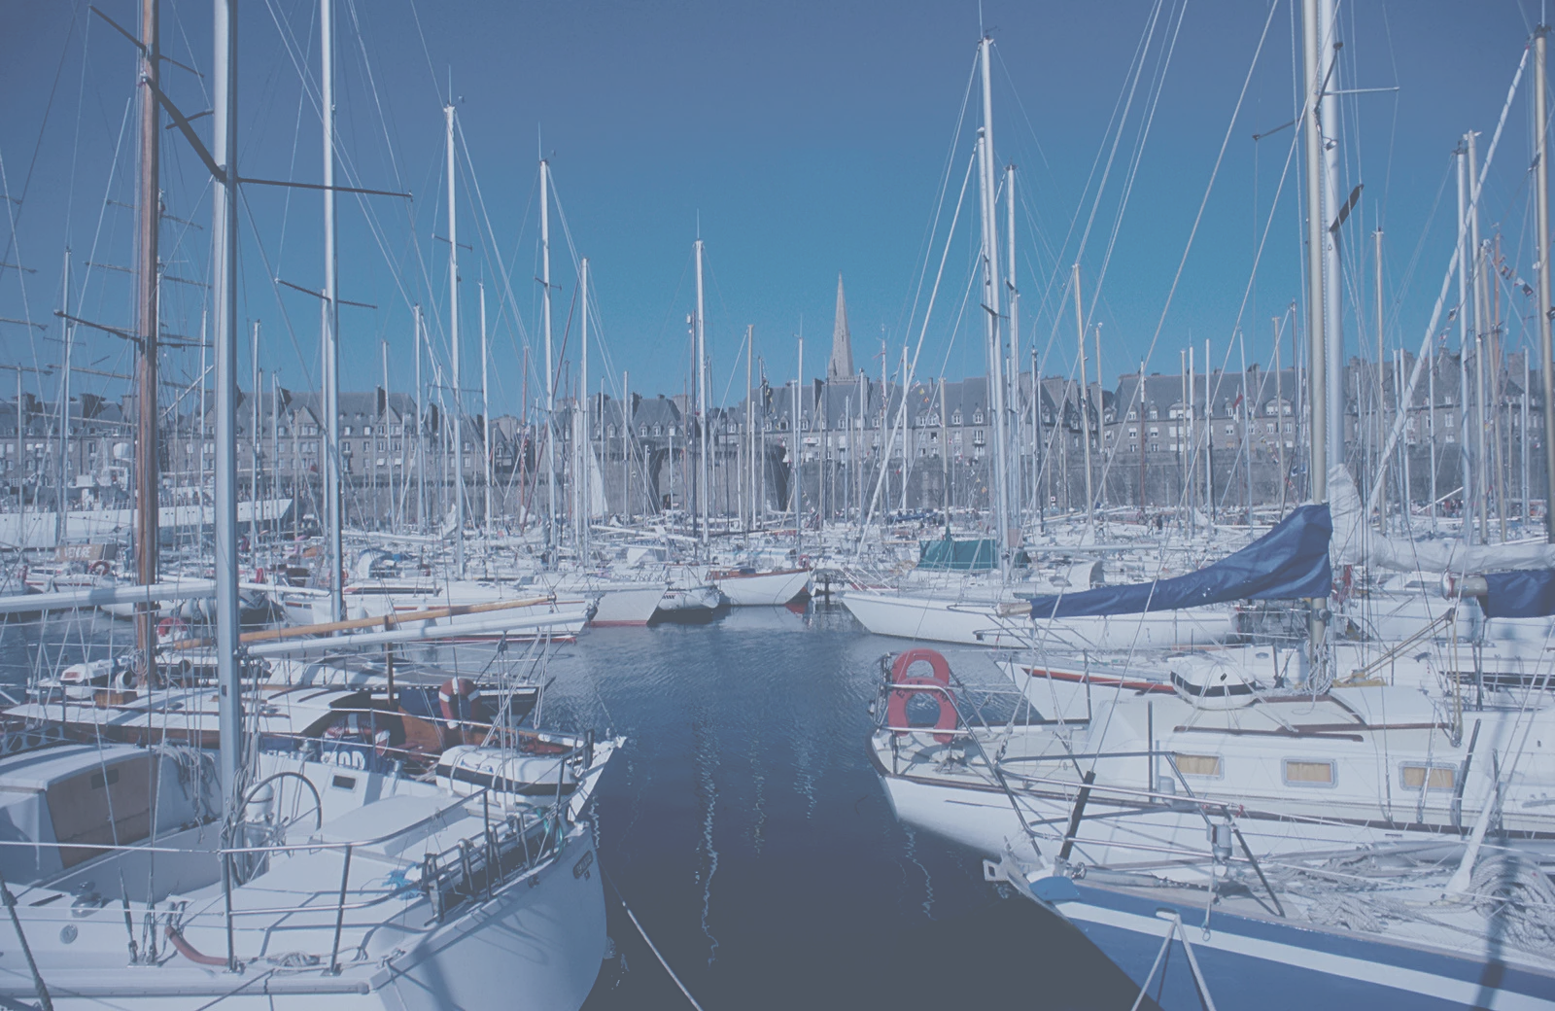

HUNTER MINI EV FESTIVAL
Solar Boat
Competition

Slide 2
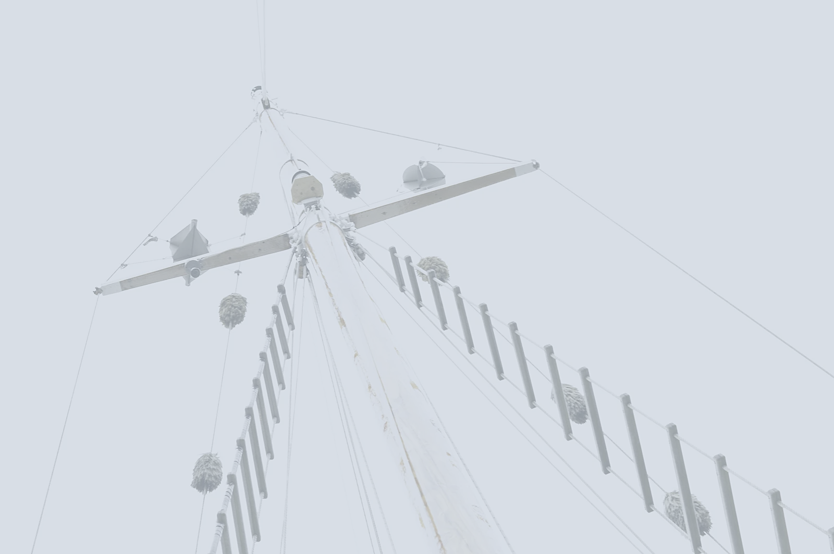
Lesson 1

Slide 3
Learning Intentions
Understand the individual elements of the design thinking cycle
Identify why design thinking is useful
Be curious about the Mini EV competition
Construct a joint timeline for the term

Slide 4
Vocabulary
Design thinking
Define
Research
Generate ideas
Plan
Make
Test
Evaluate
Empathise

Slide 5
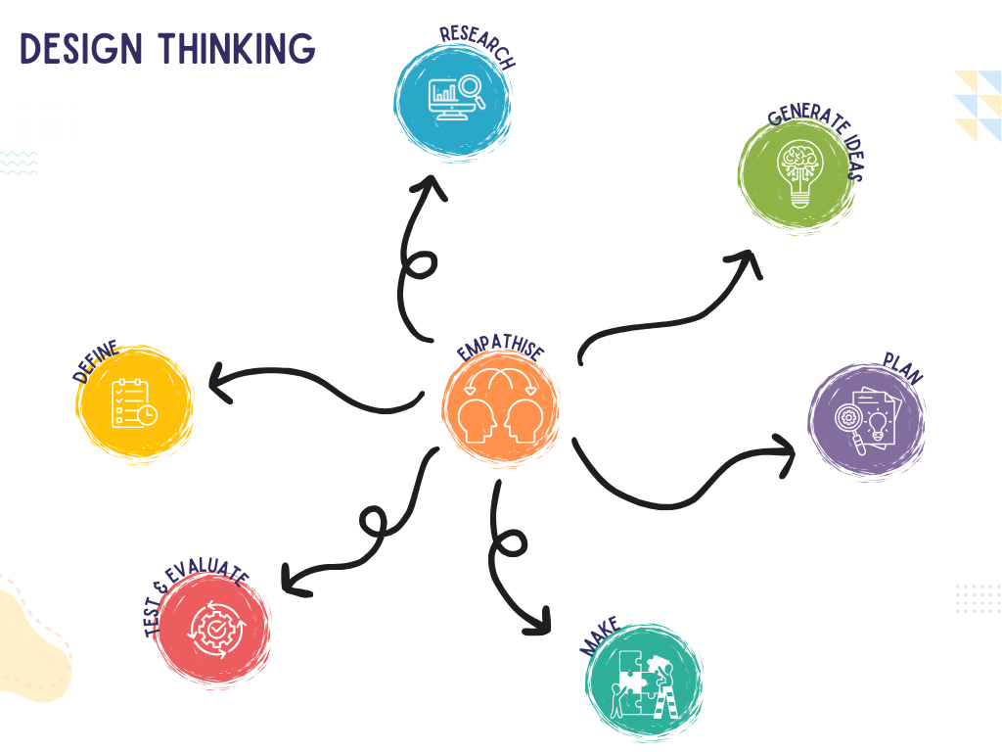
Introduction
OUR GOALS THIS TERM
Use the design thinking process to help us design, build and race solar boats.
We will need to understand the science of buoyancy, forces and solar power before we begin building!

Slide 6
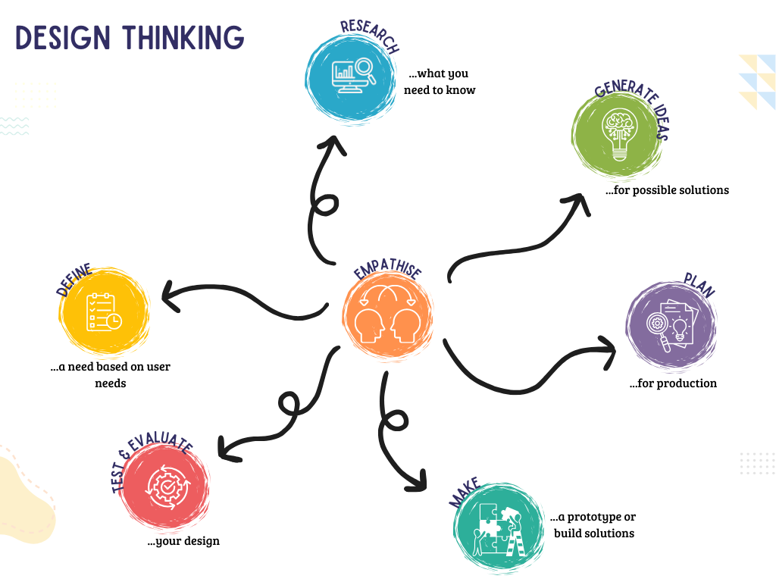

Slide 7

What is Design Thinking?
A creative problem-solving process that helps people develop solutions to challenges
Helps you learn to approach challenges creatively and collaboratively!

Slide 8
Why is Design Thinking helpful?
Design thinking is useful for several reasons:
Creativity: It encourages students to think outside the box and come up with innovative solutions to problems.
Collaboration: It promotes teamwork and communication, as students often work in groups to share ideas and feedback.
Critical Thinking: Students learn to analyse problems, consider different perspectives, and evaluate solutions based on user needs.
Hands-On Learning: The process involves creating prototypes and testing them, which makes learning interactive and engaging.
Empathy: It helps students understand the importance of considering others' needs and experiences, fostering empathy and social awareness.
Resilience: Students learn that failure is a part of the process, encouraging a growth mindset as they iterate and improve their ideas.

Slide 9
A problem to be solved
CHANGE PROBLEM TO SUIT CONTEXT
At the end of last term, Ms Smith had to move into a new STEM space, all of the resources and equipment have been put in the room but it is not at all ready for student and teacher use. How could we use design thinking to solve the problem?
How could we use design thinking to solve the problem?
Use each of the design thinking elements to discuss how you would help….

Slide 10
Research: How will things be organised? In boxes? Tubs? On shelves? Bookcases? Is there technology to be organised? If so, how will everything be charged and kept secure?
Generate ideas: Based on your research and the users needs. This could look like: labelled diagrams, lists, flow charts.
Empathise: How will you find out what is really important to Ms Smith? Is it ease of use? Aesthetics? What does she need to make the space user friendly?
Plan: How will you bring your ideas to life?
Make: Build prototypes of your ideas.
Define: Ms Smith needs an efficient way to organise the STEM space.
Test and Evaluate: Test your prototypes. Get feedback from the user (Ms Smith). What do you need to change/adapt/keep the same/add?

Slide 11
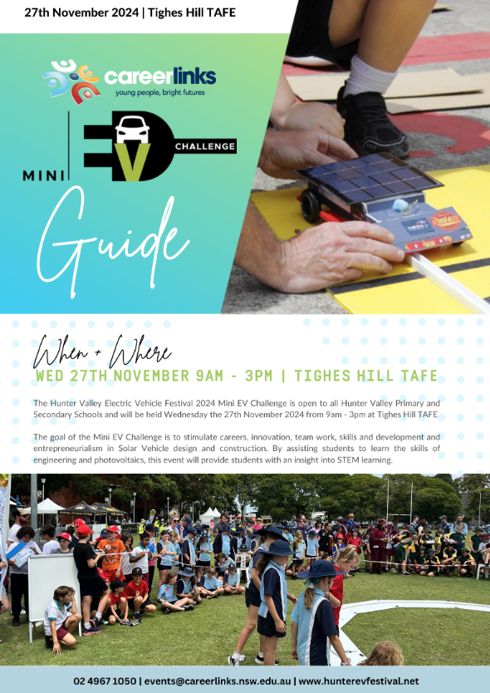

Hunter Mini EV Festival
The Details
Everything you need to know!

Slide 12
Hunter Mini EV Festival
Questions?
Anything you need to clarify…

Slide 13
Timeline
EDIT TO SUIT CONTEXT
Efficiency is key!
Week 1
Week 2
Week 3
Week 4
Week 5
Design thinking introduction
Competition details
Introduction to solar
Research
Design sketches
Generate Ideas
Plan
Make…maybe
Circuits
Make
Test
Test
Evaluate

Slide 14
Timeline
EDIT TO SUIT CONTEXT
Efficiency is key!
Week 6
Week 7
Week 8
Week 9
Week 10
Test and improve
Test and improve
Competition- Wednesday
School Race- Thursday
Dismantle
Poster creation
Reflect

Slide 15
Lesson 2
Notes:
Layout 1

Slide 16
Learning Intentions
Understand the basic principles of solar energy production
Identify concepts of buoyancy, density and displacement
Create a clay boat, designed to carry a small weight

Slide 17
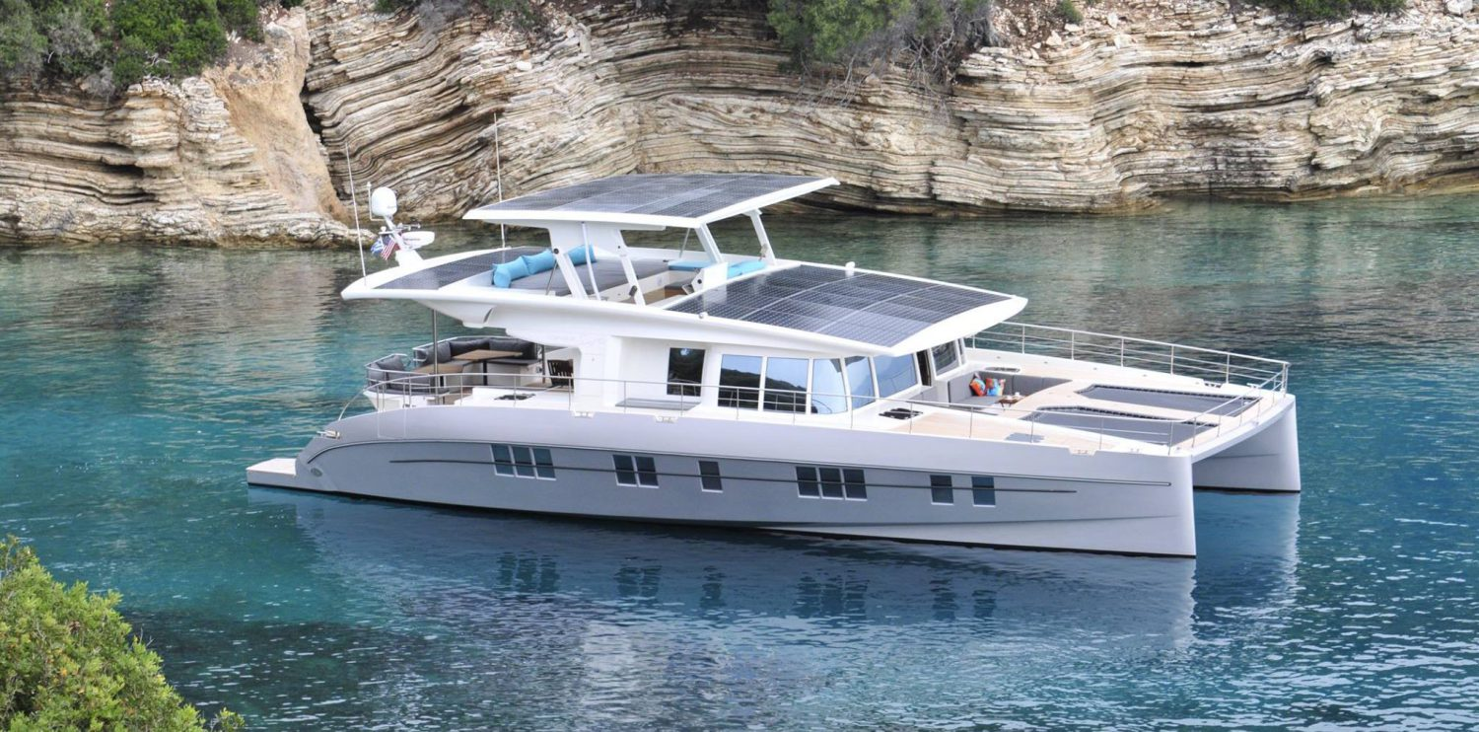

Vocabulary
Circuit: A device that provides a path for electric current to flow
Thermal Energy: heat energy
Radiant Energy: light energy
Reflection: bouncing energy back without absorbing it
Absorption: take in heat energy
Solar panel: collect sunlight and change radiant energy into electricity
Solar Energy: Energy that comes directly from the sun
Voltage: the difference in energy between two points

Slide 18
Vocabulary
Buoyancy
Density
Displacement

Slide 19
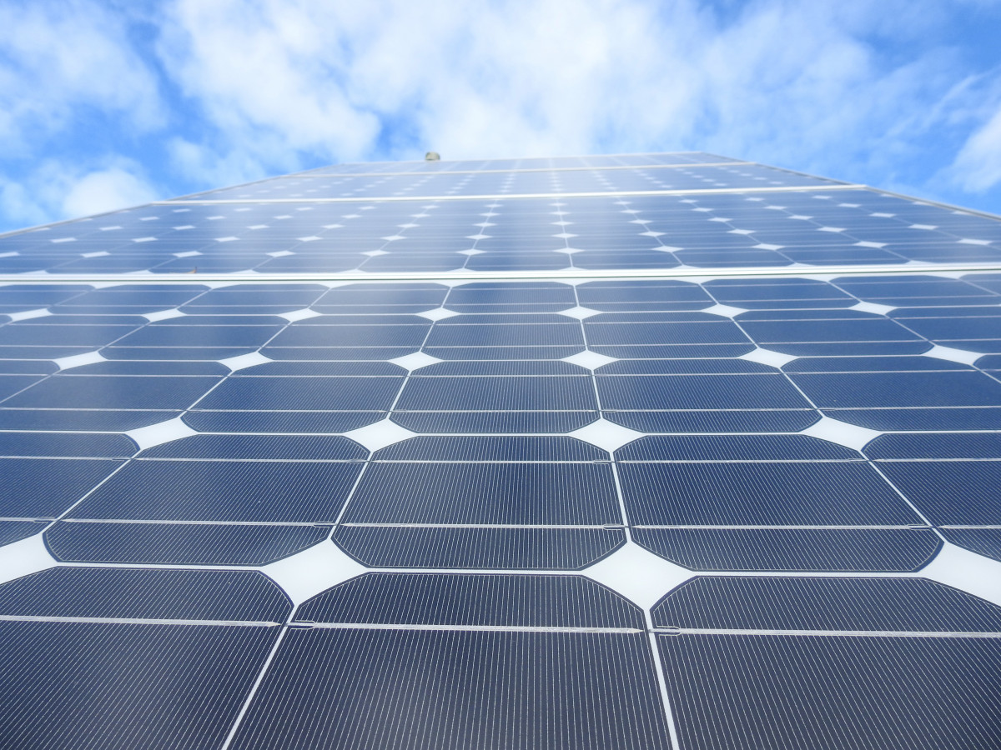
Understanding Solar Energy
WALT: Understand how energy from the sun
transfers into electrical and mechanical
energy.

Slide 20
Understanding Solar Energy
These boats use solar photovoltaic systems to power them.
Solar photovoltaic systems convert sunlight into electricity.
Solar photovoltaic (PV) devices, or solar cells, change sunlight directly into electricity.

Slide 21
Understanding Solar Energy
Small PV cells can power calculators, watches, and other small electronic devices.
Arrangements of many solar cells in PV panels and arrangements of multiple PV panels in PV arrays can produce electricity for an entire house.
Some PV power plants have large arrays that cover many acres to produce electricity for thousands of homes.

Slide 22
Benefits of Solar Energy
Energy systems do not produce air pollutants or carbon dioxide.
Solar energy systems on buildings have minimal effects on the environment.

Slide 23
Limitations of Solar Energy
The amount of sunlight that arrives at the earth’s surface is not constant.
The amount of sunlight varies depending on location, time of day, the season of the year, and weather conditions.
The amount of sunlight reaching a square foot of the earth’s surface is relatively small, so a large surface area is necessary to absorb or collect a useful amount of energy.

Slide 24
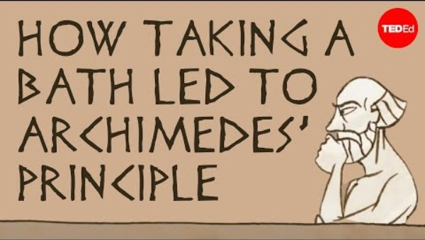
Buoyancy and Density
TED Ed Thinking Task
Buoyancy explained!

Slide 25
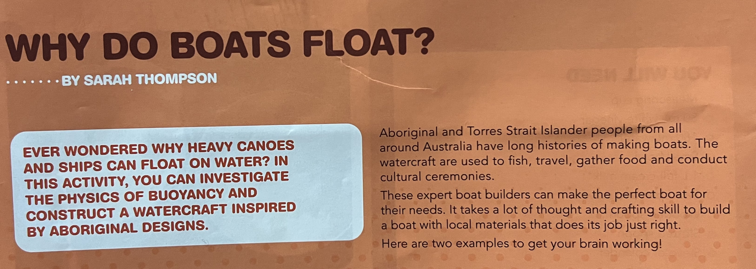
Why do boats float?
Notes:
Adapted from ‘Why do boats float?’ by Sarah Thompson, which first appeared in Double Helix magazine, Questacon Engineering Special Issue, p.24-25. For more hands-on science activities visit doublehelix.csiro.au

Slide 26
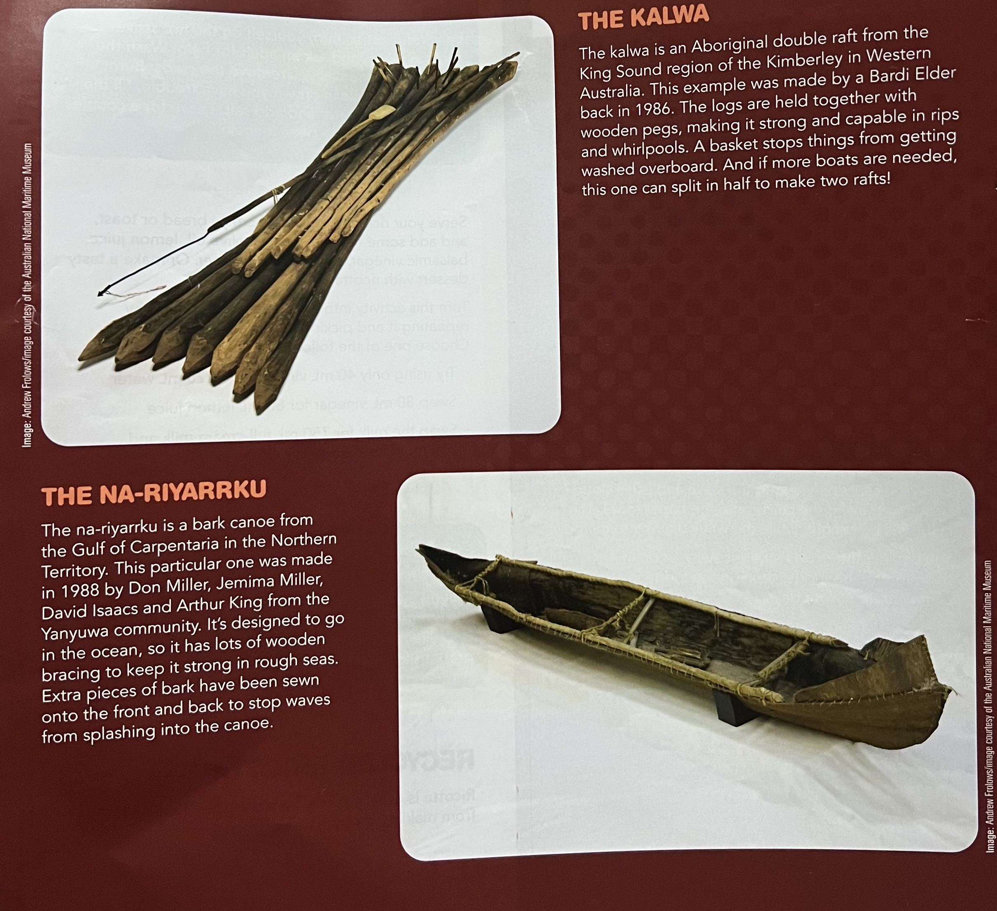
Why do boats float?
Notes:
Adapted from ‘Why do boats float?’ by Sarah Thompson, which first appeared in Double Helix magazine, Questacon Engineering Special Issue, p.24-25. For more hands-on science activities visit doublehelix.csiro.au

Slide 27
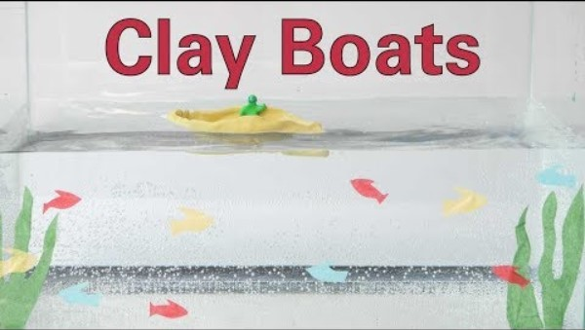



Building clay boats
YOU WILL NEED
Plasticine/clay (approx. 200g per group/student) Small sticks or paper bark String Scissors Container of water Small pebbles/weights
DESIGN AND BUILD
Using a piece of clay/plasticine, design a boat that will hold a small amount of weight. Test your boat in the container of water. What changes/improvements can you make?

Slide 28
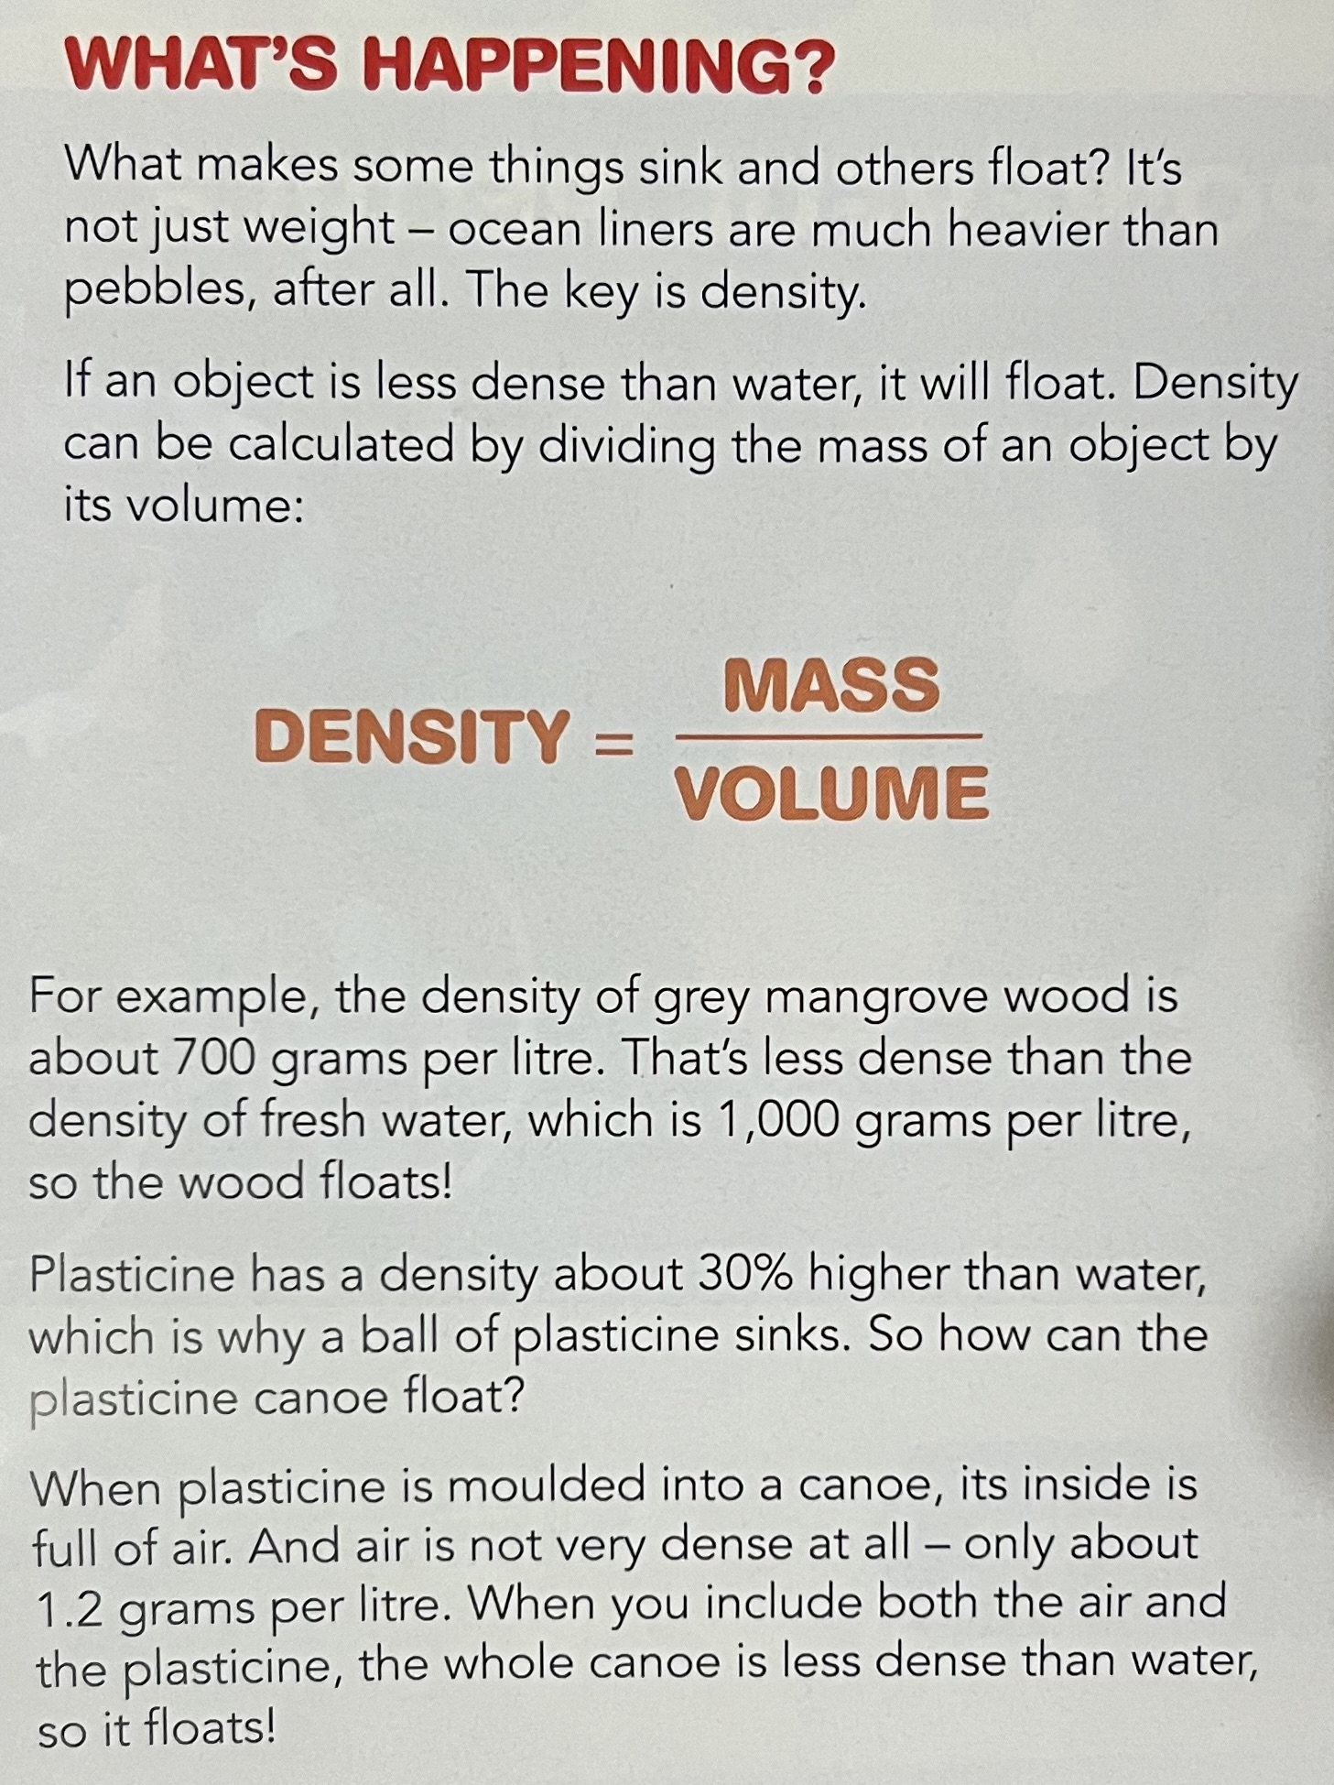
What is happening?
Notes:
Adapted from ‘Why do boats float?’ by Sarah Thompson, which first appeared in Double Helix magazine, Questacon Engineering Special Issue, p.24-25. For more hands-on science activities visit doublehelix.csiro.au

Slide 29
Reflection
EDIT TO INCLUDE CLASS RESPONSES
What worked? | What didn’t?
Higher walls NO cracks Centre board Bowl shape Pinching corners Test and redesign Thicker bottom thinner walls | Shorter walls Depth of vessel holding the water (haha) Over engineering Square prism Ball – too dense Thin Too long or too short

Slide 30
Reflection
THREE - TWO - ONE Thinking Routine
Three science concepts that I learned and applied in this activity are…
Two science and engineering skills that I used in this activity are…
One idea I have to further explore and extend this activity is…

Slide 31
Lesson 3
Notes:
Layout 1

Slide 32
Learning Intentions
Complete an empathy map to build a deeper understanding of users' needs and wants
Identify the key components of electoral circuits
Be able to create a simple, closed and series circuit

Slide 33
Vocabulary
Simple circuit
Closed circuit
Open circuit
Series circuit

Slide 34
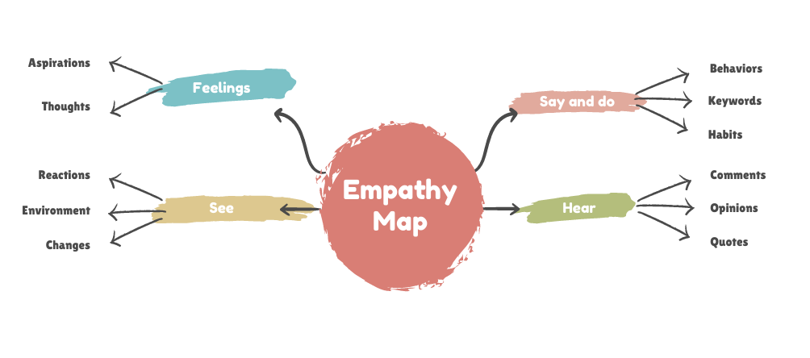


Slide 35
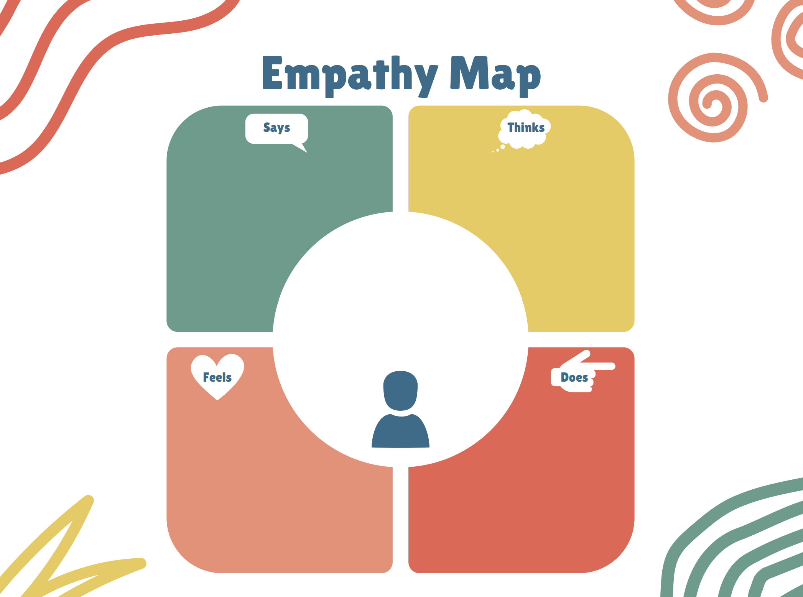

Slide 36
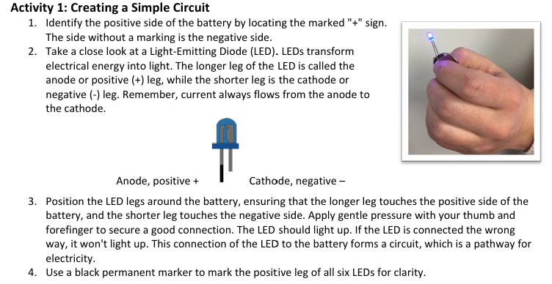
Paper Circuits

Slide 37
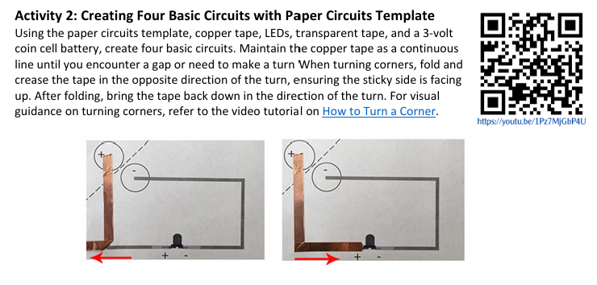
Paper Circuits

Slide 38
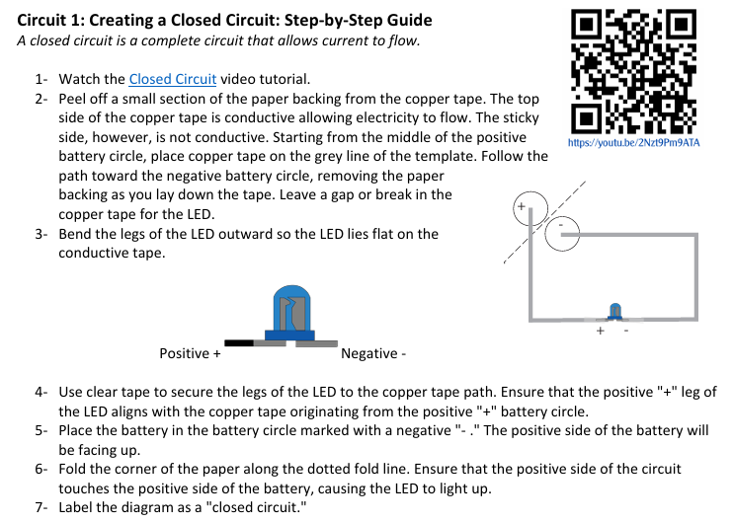
Paper Circuits

Slide 39
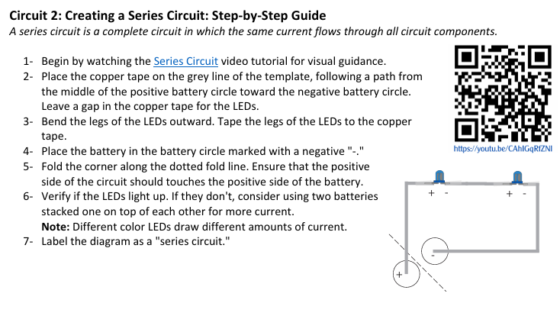
Paper Circuits

Slide 40
Lesson 4 + 5
Notes:
Layout 1

Slide 41
Learning Intentions
Codesign a problem statement for the design thinking process
Research and analyse boat hull designs
Produce a labelled diagram/s
Collaborate on final hull shape design
Create a template for your hull

Slide 42
Vocabulary
Problem statement
Isometric
Labelled diagram
Hull

Slide 43
Defining the problem statement
Summarise the problem (2 minutes) | Define the Problem Statement
User needs to be able to: ? ? | ___________________ (name of user) Need a way to: _________________________ (user needs)

Slide 44
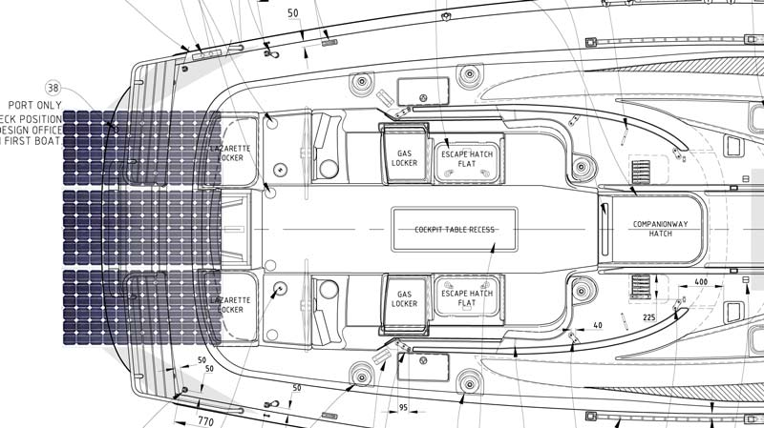
Design Overview
To guide your research
Basic components (see kit)
Hull design and weight distribution (symmetry is key)
Key engineering challenges (efficiency, durability)

Slide 45
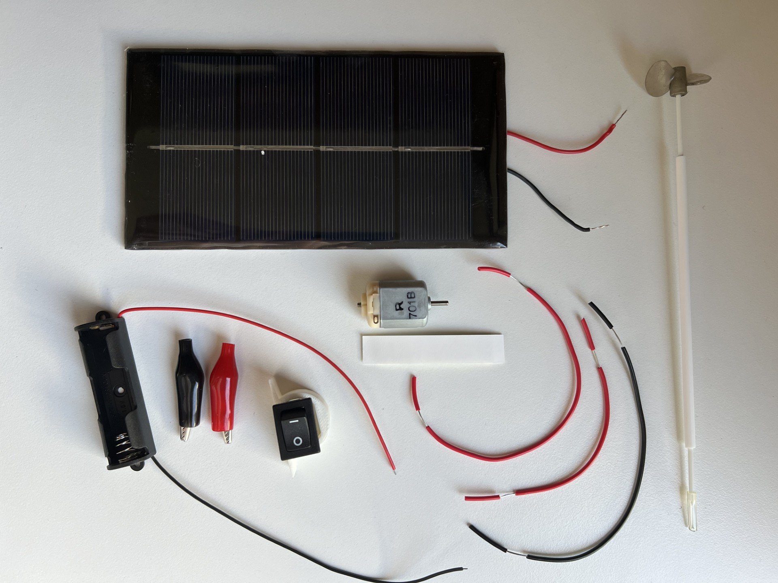
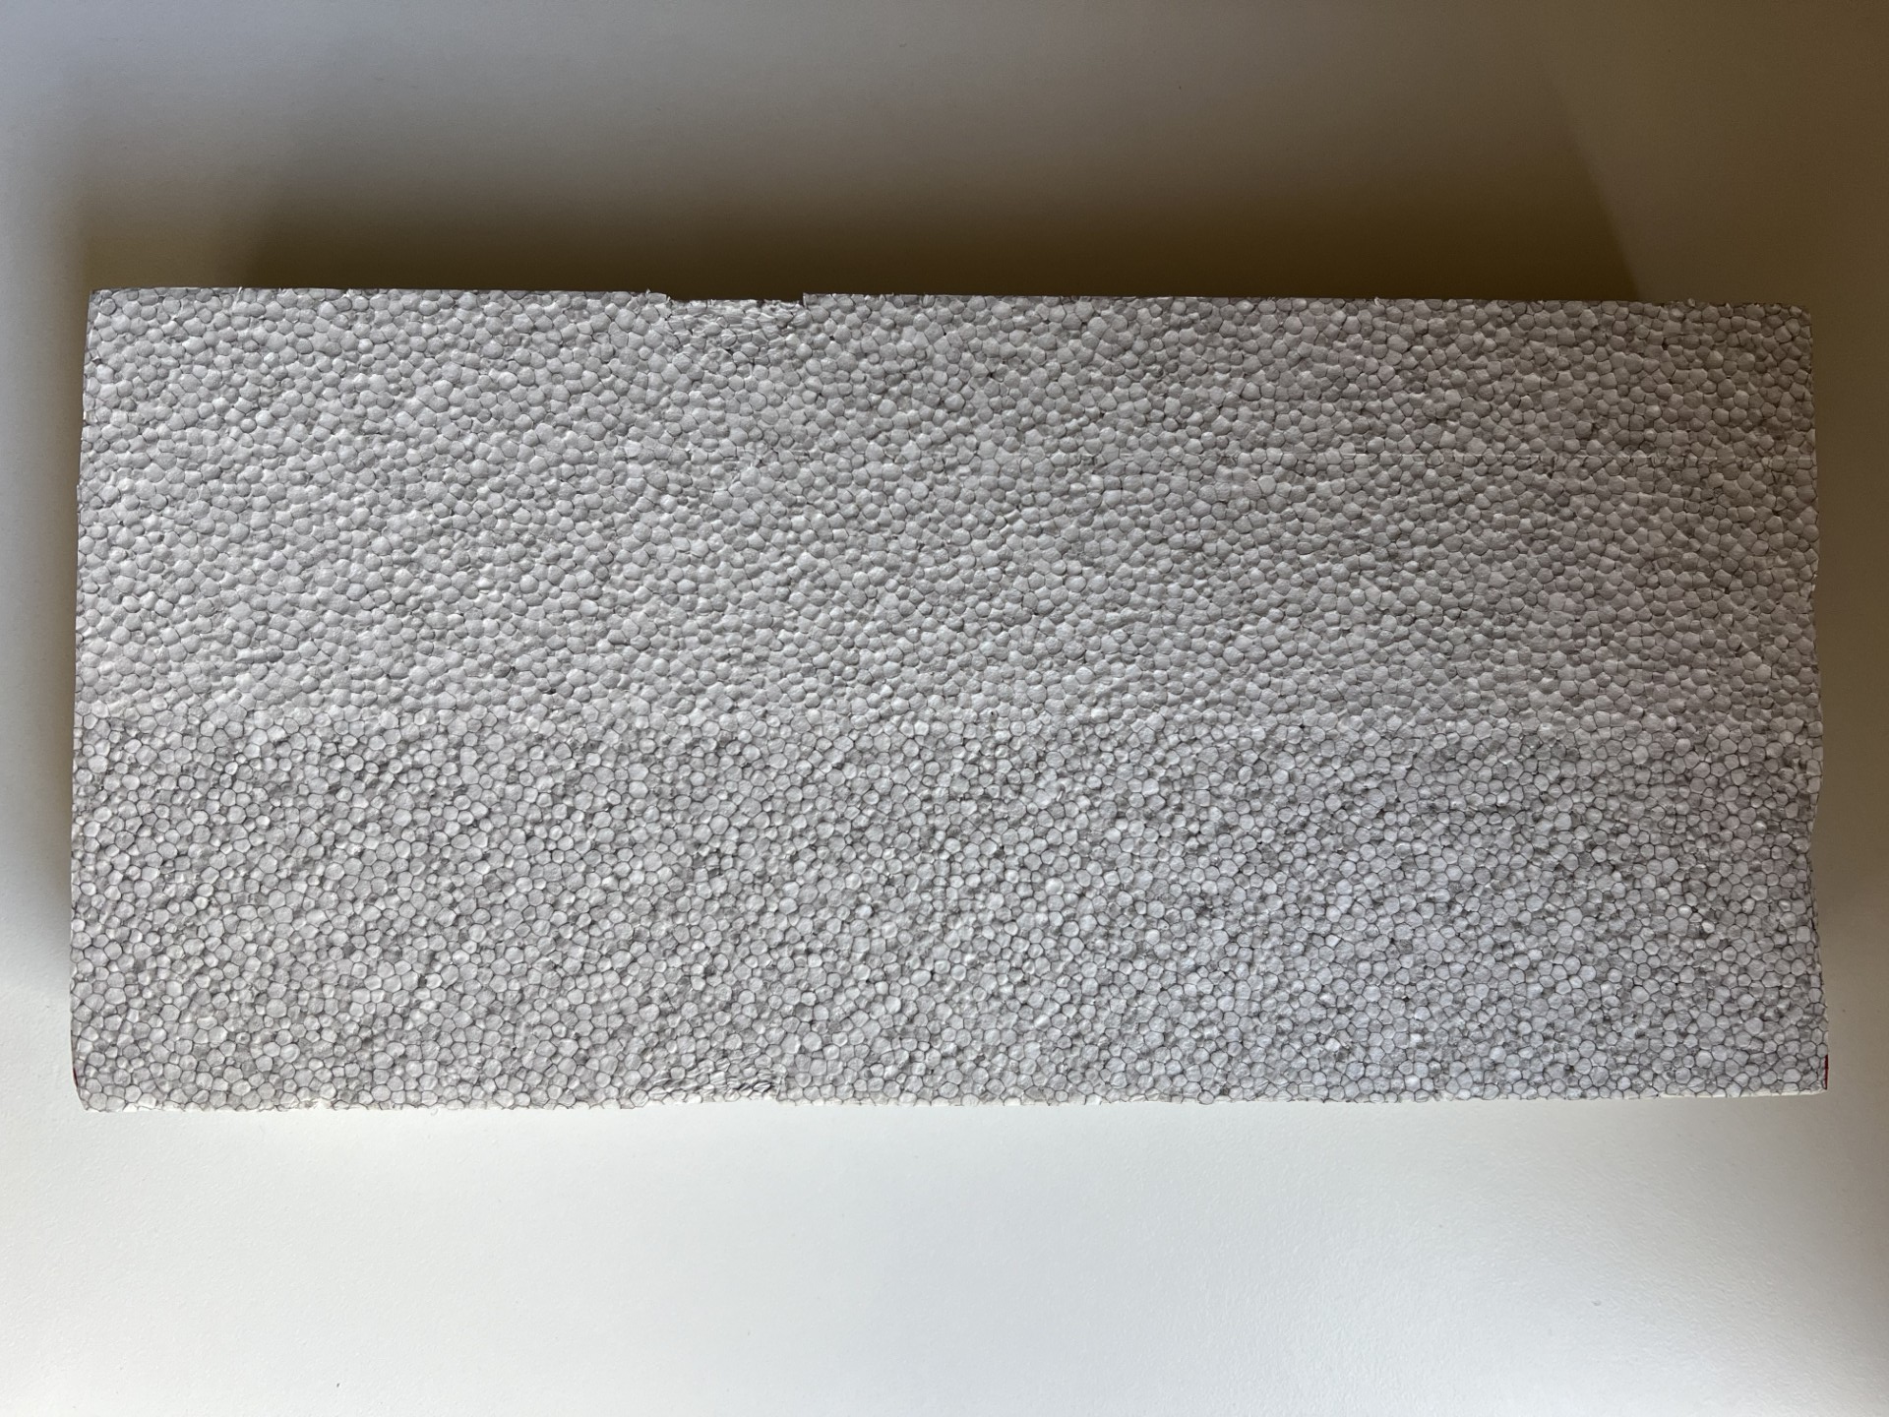
Kit Components
1 Motor + 3D Mount + double sided tape
1 Propeller & shaft kit
3 Pieces of wire
1 Switch
2 Alligator clips
1 Battery pack
1 Block of Polystyrene 330mmx150mmx 50mm

Slide 46
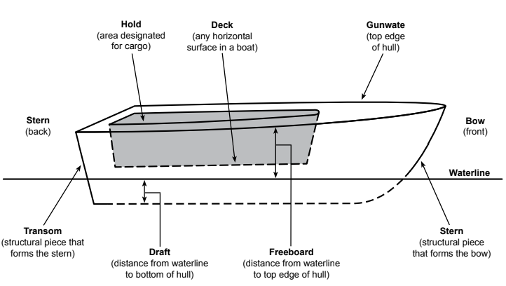

Boat Hull Elements
Reference: boat_hull_design_kit_ug_56812.pdf

Slide 47
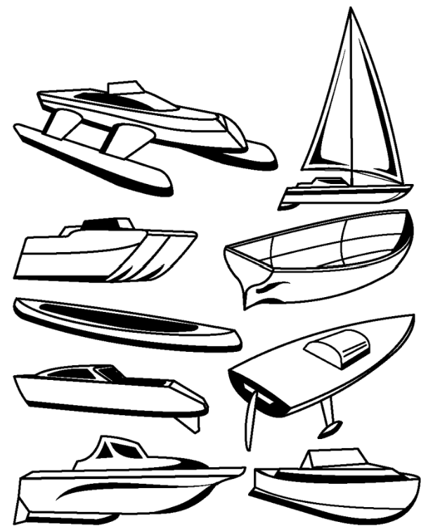
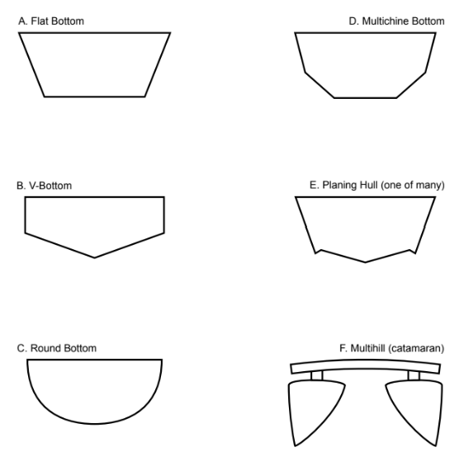
Boat Hull Shapes
Reference: boat_hull_design_kit_ug_56812.pdf

Slide 48
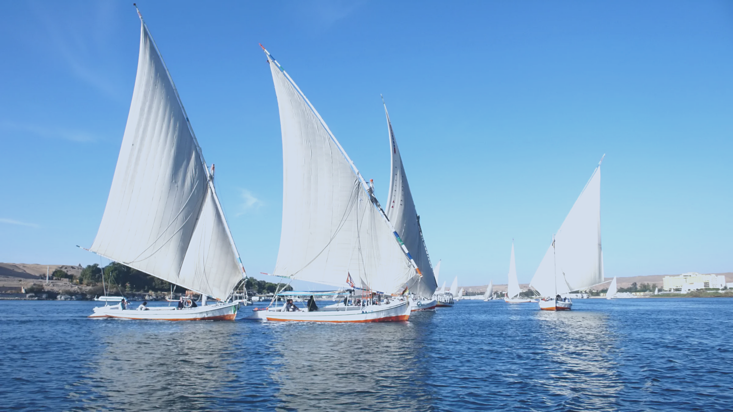
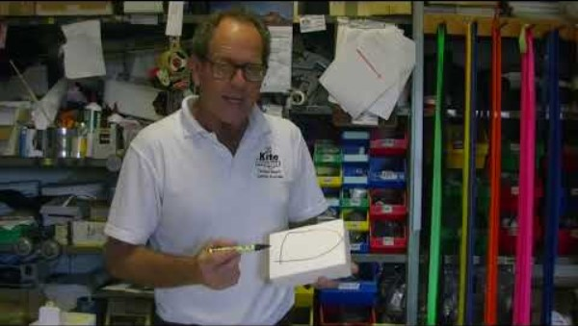
Designing your boat
To guide your research
https://www.boaterexam.com/boating-resources/boat-hull-types-designs/
https://driveaboatusa.com/blog/boat-hull-types-and-shapes/

Slide 49
Drawing in three dimensions
Tutorial 1. Sketching a Dinghy and Sailboat
Tutorial 2. Sketching Motor Yacht and Cruise Ship
Tutorial 3. Sketching Pilot boat and Container Ship

Slide 50
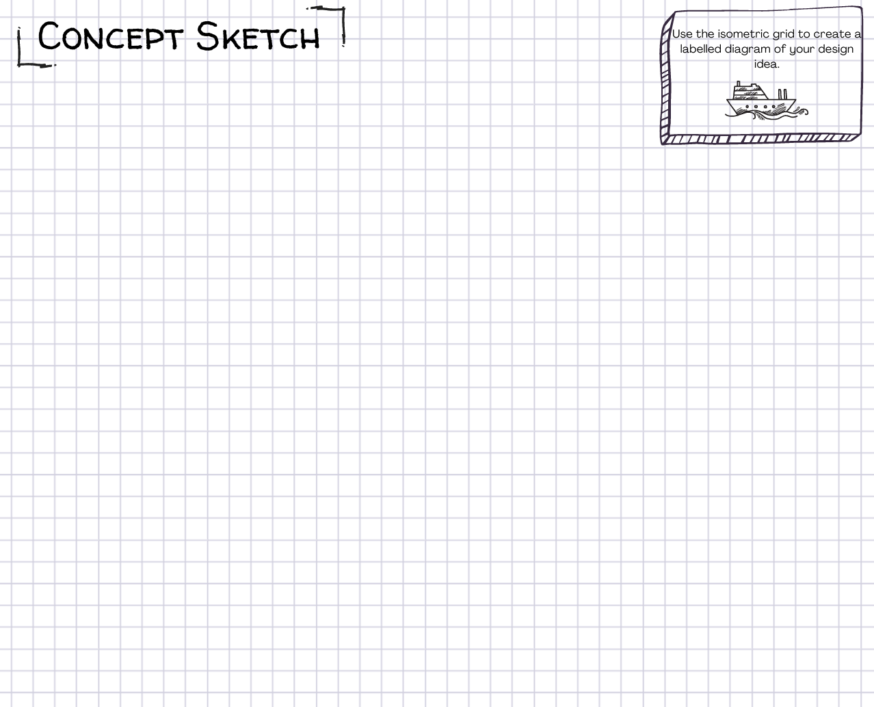
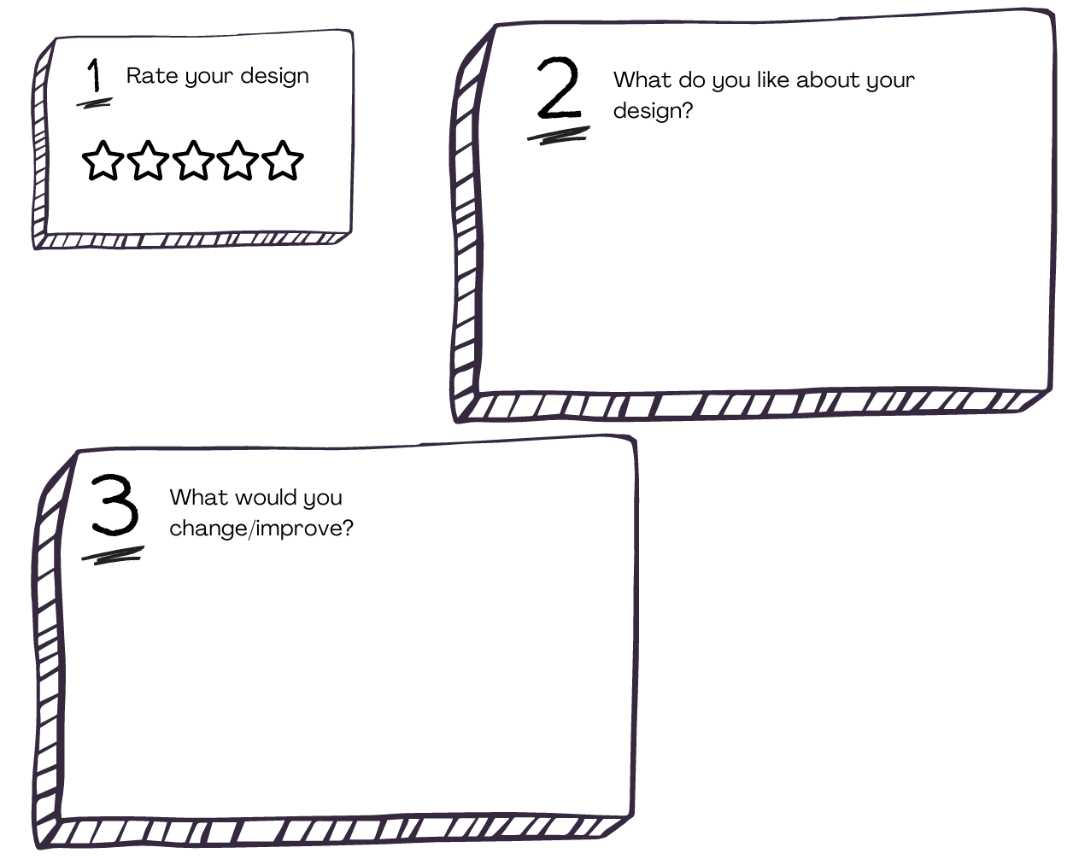
Concept Sketch
Produce your individual concept sketch
Compare with your group members
Complete your individual reflection
Share your reflections
Combine your ideas into ONE final group design

Slide 51
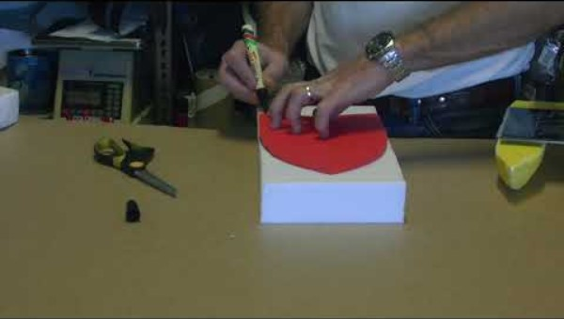
Hull Template
Combine your research and design sketches to create a final template for your hull design. This template will be used to cut the shape of your hull from your Styrofoam block.
Watch this first:

Slide 52
Lesson 6-8
Notes:
Layout 1

Slide 53
Your Goals
Jointly construct based on the amount of time/lessons you have allocated for building, testing and evaluating.

Slide 54
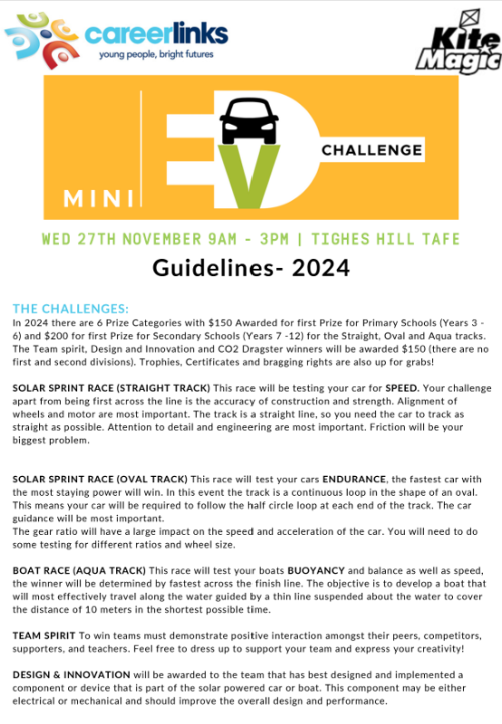
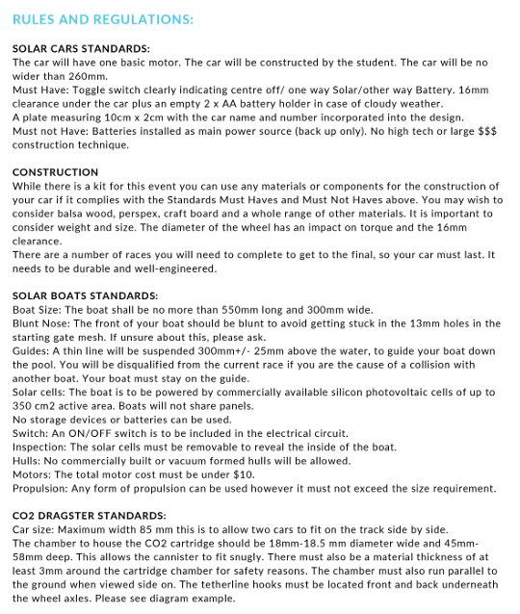
Competition Guidelines Recap
Review: Competition guidelines and watch this example of the boat race. UPDATE FOR 2025?

Slide 55
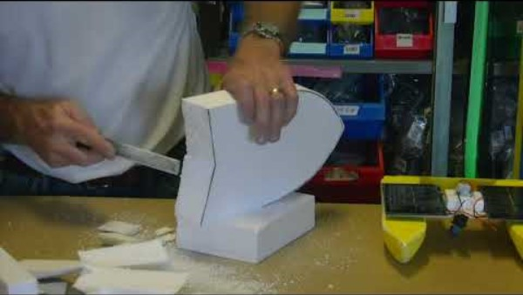
Shaping Your Boat

Slide 56
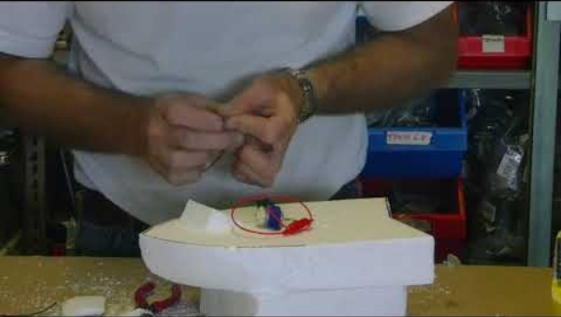
How to Build Your Circuit

Slide 57
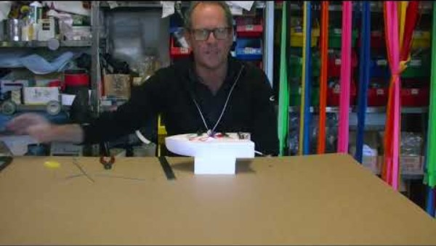
Guides for Your Boat

Slide 58
Time to CREATE!
Now is your time to build, test, evaluate and rebuild as many times as you need to!
Think about environmental factors that impact performance
3D print options: guidance system, wheels, chassis, anything else you can imagine!

Slide 59
Lesson 9 + 10
Notes:
Layout 1

Slide 60
Communicate
Create a one-page overview (handwritten or digital) to communicate the process of designing and building your solar boat.
Your design should communicate the different elements of the design thinking cycle and include a detailed labelled diagram.
If time permits or you want to really extend your thinking, you may wish to use a more detailed communication platform such as a pitch deck, virtual learning environment, website, infographic or instructional video.

Slide 61
Battle of the boats
Create a draw for your teams to battle each other before deconstructing their boats!

Slide 62
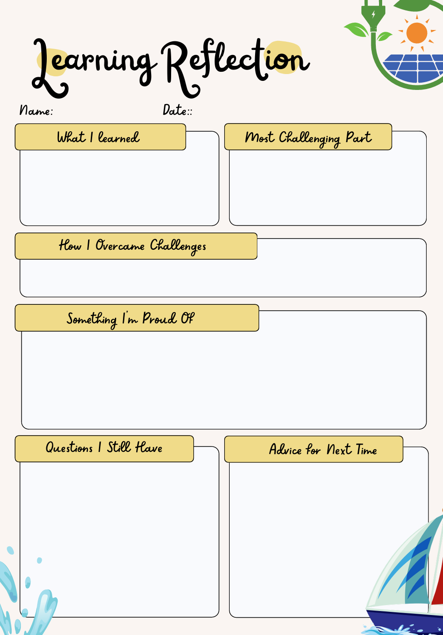
Evaluate + Reflect
Think about:
The whole process – from your original concept sketch to the final build
Modification and changes you had to make (to your design and your thinking)
How you worked as part of a team – your cooperation and commitment
The actual race day

