Slide 1
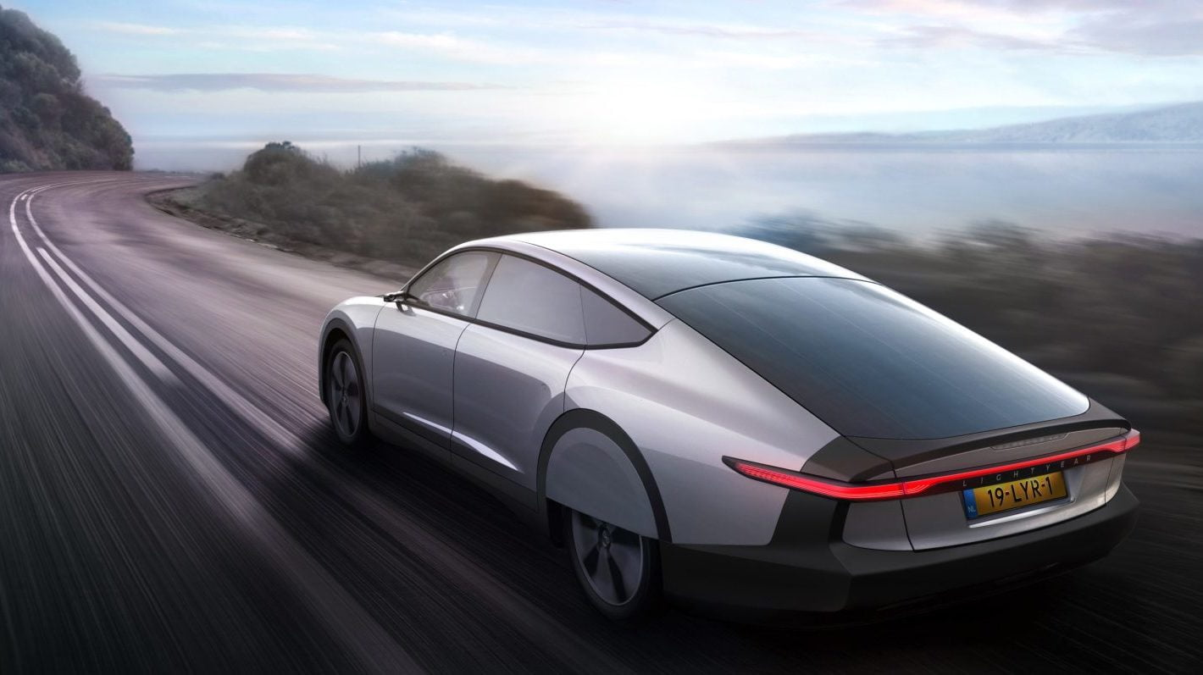

HUNTER MINI EV FESTIVAL
Solar Car
Competition

Slide 2
Lesson 1

Slide 3
Learning Intentions
Understand the individual elements of the design thinking cycle
Identify why design thinking is useful
Be curious about the Mini EV competition
Construct a joint timeline for the term

Slide 4
Vocabulary
Design thinking
Define
Research
Generate ideas
Plan
Make
Test
Evaluate
Empathise

Slide 5
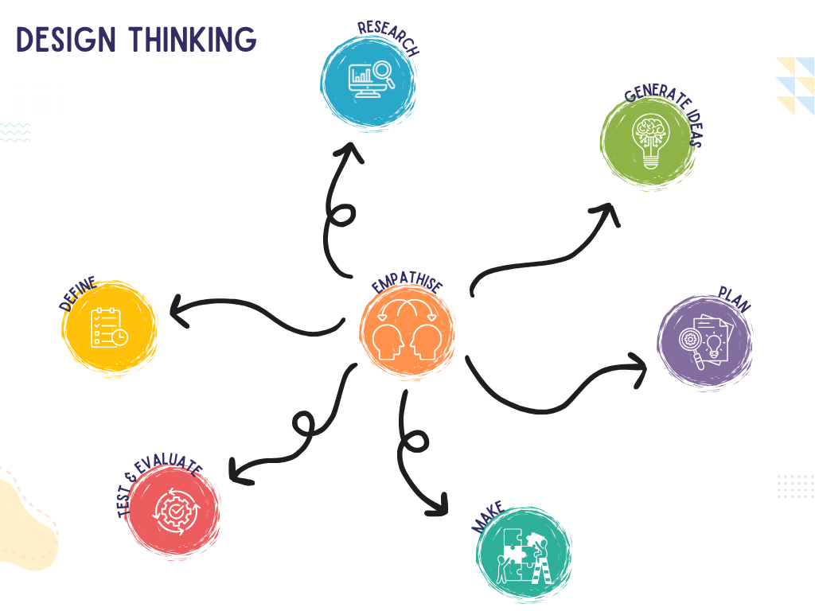
Introduction
OUR GOALS THIS TERM
Use the design thinking process to help us design, build and race solar cars.
We will need to understand the science of buoyancy, forces and solar power before we begin building!

Slide 6
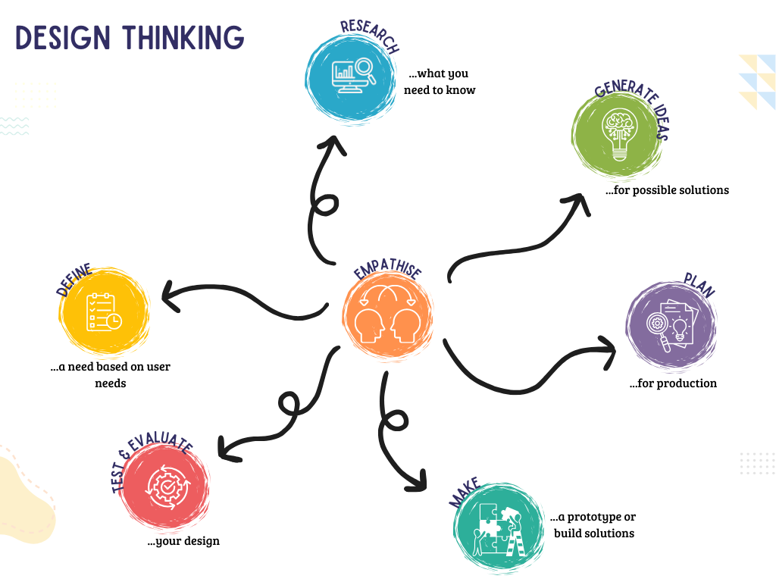

Slide 7
What is Design Thinking?
A creative problem-solving process that helps people develop solutions to challenges
Helps you learn to approach challenges creatively and collaboratively!

Slide 8
Why is Design Thinking helpful?
Design thinking is useful for several reasons:
Creativity: It encourages students to think outside the box and come up with innovative solutions to problems.
Collaboration: It promotes teamwork and communication, as students often work in groups to share ideas and feedback.
Critical Thinking: Students learn to analyse problems, consider different perspectives, and evaluate solutions based on user needs.
Hands-On Learning: The process involves creating prototypes and testing them, which makes learning interactive and engaging.
Empathy: It helps students understand the importance of considering others' needs and experiences, fostering empathy and social awareness.
Resilience: Students learn that failure is a part of the process, encouraging a growth mindset as they iterate and improve their ideas.

Slide 9
A problem to be solved
CHANGE PROBLEM TO SUIT CONTEXT
At the end of last term, Ms Smith had to move into a new STEM space, all of the resources and equipment have been put in the room but it is not at all ready for student and teacher use. How could we use design thinking to solve the problem?
How could we use design thinking to solve the problem?
Use each of the design thinking elements to discuss how you would help….

Slide 10
Research: How will things be organised? In boxes? Tubs? On shelves? Bookcases? Is there technology to be organised? If so, how will everything be charged and kept secure?
Generate ideas: Based on your research and the users needs. This could look like: labelled diagrams, lists, flow charts.
Empathise: How will you find out what is really important to Ms Smith? Is it ease of use? Aesthetics? What does she need to make the space user friendly?
Plan: How will you bring your ideas to life?
Make: Build prototypes of your ideas.
Define: Ms Smith needs an efficient way to organise the STEM space.
Test and Evaluate: Test your prototypes. Get feedback from the user (Ms Smith). What do you need to change/adapt/keep the same/add?

Slide 11


Hunter Mini EV Festival
The Details
Everything you need to know!

Slide 12

Hunter Mini EV Festival
Questions?
Anything you need to clarify…

Slide 13
Timeline
EDIT TO SUIT CONTEXT
Efficiency is key!
Week 1
Week 2
Week 3
Week 4
Week 5
Design thinking introduction
Competition details
Introduction to solar
Research
Design sketches
Generate Ideas
Plan
Make…maybe
Circuits
Make
Test
Test
Evaluate

Slide 14
Timeline
EDIT TO SUIT CONTEXT
Efficiency is key!
Week 6
Week 7
Week 8
Week 9
Week 10
Test and improve
Test and improve
Competition- Wednesday
School Race- Thursday
Dismantle
Poster creation
Reflect

Slide 15
Lesson 2

Slide 16
Learning Intentions
Understand the basic principles of solar energy production
Identify concepts of inertia, friction and momentum
Design, build and race a gravity racer

Slide 17
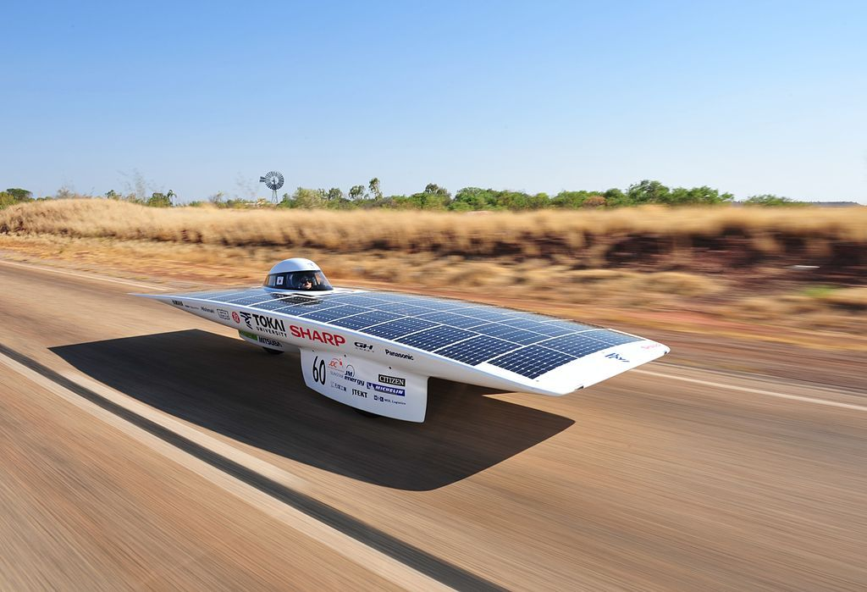

Vocabulary
Circuit: A device that provides a path for electric current to flow
Thermal Energy: heat energy
Radiant Energy: light energy
Reflection: bouncing energy back without absorbing it
Absorption: take in heat energy
Solar panel: collect sunlight and change radiant energy into electricity
Solar Energy: Energy that comes directly from the sun
Voltage: the difference in energy between two points

Slide 18
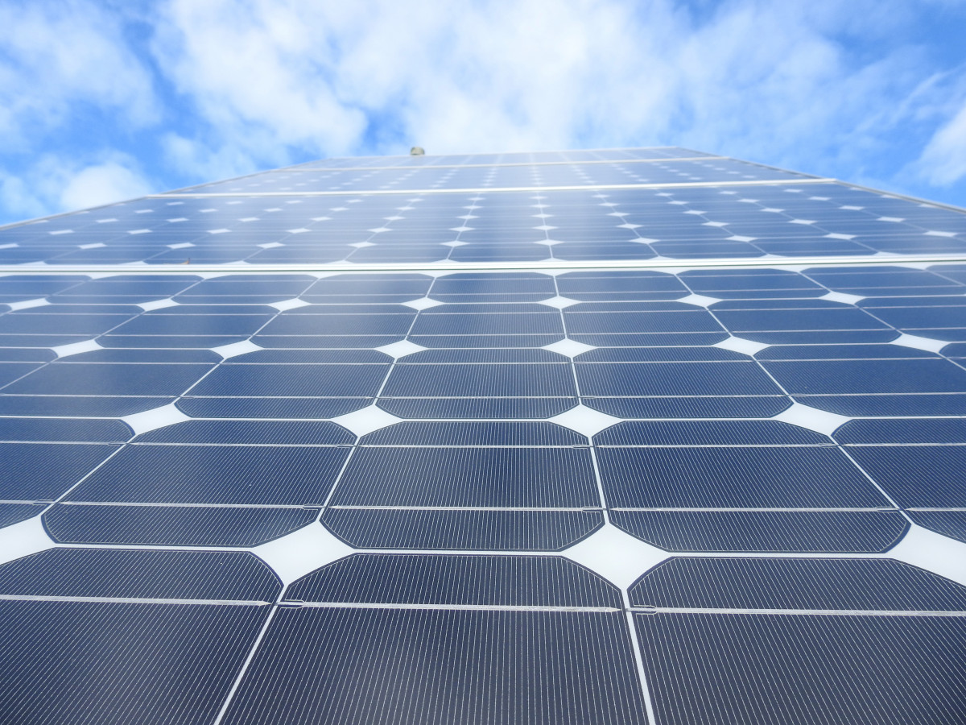
Understanding Solar Energy
WALT: Understand how energy from the sun
transfers into electrical and mechanical
energy.

Slide 19
Understanding Solar Energy
These cars use solar photovoltaic systems to power them.
Solar photovoltaic systems convert sunlight into electricity.
Solar photovoltaic (PV) devices, or solar cells, change sunlight directly into electricity.

Slide 20
Understanding Solar Energy
Small PV cells can power calculators, watches, and other small electronic devices.
Arrangements of many solar cells in PV panels and arrangements of multiple PV panels in PV arrays can produce electricity for an entire house.
Some PV power plants have large arrays that cover many acres to produce electricity for thousands of homes.

Slide 21
Benefits of Solar Energy
Energy systems do not produce air pollutants or carbon dioxide.
Solar energy systems on buildings have minimal effects on the environment.

Slide 22
Limitations of Solar Energy
The amount of sunlight that arrives at the earth’s surface is not constant.
The amount of sunlight varies depending on location, time of day, the season of the year, and weather conditions.
The amount of sunlight reaching a square foot of the earth’s surface is relatively small, so a large surface area is necessary to absorb or collect a useful amount of energy.

Slide 23
How will your solar car work?
Solar energy is made up of particles called photons.
When the sunlight (or photons) hit the solar cell, it charges the electrons causing them to flow through the wire.
When the charged electrons flow to the motor, it allows the motor to turn, therefore turning the wheels of the car!

Slide 24
Laws of Conversion of Energy
Watch: https://www.youtube.com/watch?v=O4Rxb-3jIqQ
Discuss: Energy can be neither created nor destroyed, it can only be transferred to another object or transformed into another form.
What about ‘hidden energy’? See the graphic on the next slide for some interesting examples!

Slide 25
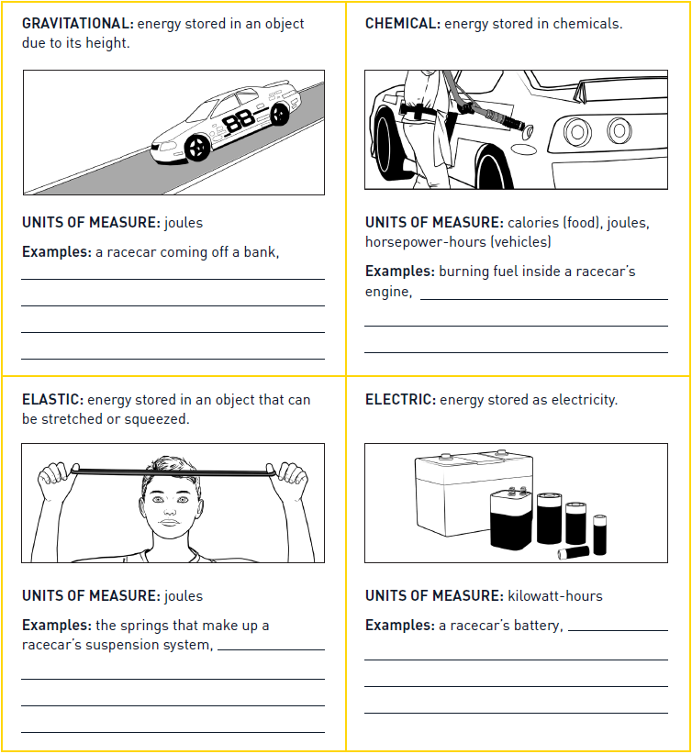

Slide 26
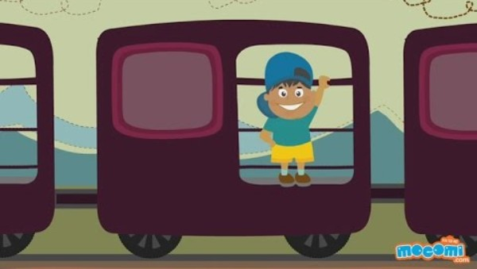
Gravity Racers
Watch: What is Inertia? - Newton's Law | Physics lesson for Kids | Kids Education by Mocomi Kids
Discuss and define: gravity - Kids | Britannica Kids | Homework Help

Slide 27
Gravity Racers
No more than 10cm length x 5cm width
May use generic (non-car) building toy sets like LEGO, k'Nex, Magnetix, Erector, etc.
May decorate with anything you like
May use toy wheels, bottle caps, or any other round objects for wheels (dollar/bargain/thrift stores & garage sales are great sources for stuff).
Gravity powered only: may not have any drive/propulsion motors/balloons/rubber bands/springs, etc.

Slide 28
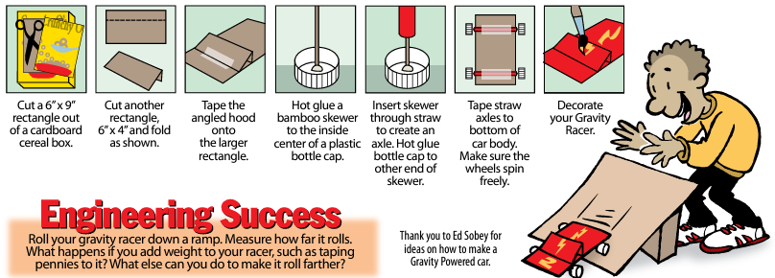
Gravity Racers

Slide 29
Gravity Racers
1st competition-fastest time down the ramp
2nd competition-inertia/friction-furthest from base of ramp
3rd competition-momentum-pushes an object the furthest from base of ramp

Slide 30

Reflection
EDIT TO INCLUDE CLASS RESPONSES
What worked? | What didn’t?
? ? | ? ?

Slide 31
Reflection
THREE - TWO - ONE Thinking Routine
Three science concepts that I learned and applied in this activity are…
Two science and engineering skills that I used in this activity are…
One idea I have to further explore and extend this activity is…

Slide 32
Lesson 3

Slide 33
Learning Intentions
Understand the concepts of mass, force, momentum and friction and how they impact car design and efficiency.
Design, build and test a balloon powered car.

Slide 34
Vocabulary
Mass
Force
Momentum
Friction

Slide 35
Introduction
Newton’s third law
For every action, there is an equal and opposite reaction. Rockets propel by pushing gases out quickly, creating a force that moves the rocket in the opposite direction. Faster gas ejection generates more force for propulsion.
Mass
A lighter mass accelerates faster than a heavier mass under the same force. This principle applies to rockets and objects like balloon cars. A light person on a swing speeds up quicker than a heavy person with the same push.
Force
To maximize speed in a balloon car, use a fresh, well-inflated balloon to increase forward force while minimizing friction from wheels and air resistance.
Momentum
Once a car is in motion, it will continue moving due to momentum, defined as mass multiplied by velocity. Newton's first law explains that objects at rest stay at rest and moving objects stay in motion at a constant speed in a straight line unless acted upon by an external force.
Friction
The car slows down and stops because of friction, which includes air resistance and surface friction between the axle, body, wheels, and ground. Minimizing surface friction is more crucial than streamlining for reducing resistance.

Slide 36
Balloon Powered Cars
Introduce the challenge: Build a Balloon Car | STEM Activity
Watch: Science Max | How to Make a Balloon Powered Car | Science Experiments
Then begin building and racing!

Slide 37
Balloon Powered Cars
To run the competition, line the students up on a line at the competition area – a school hall with wooden floors or an outside court with smooth concrete will work well.
Countdown from 10 to allow students time to blow up their balloons ready to release on “Go!”
You may like to repeat the competition several times.

Slide 38
Reflection
Which cars worked best? Why?
How does the mass of the car make a difference? What would happen if the car could be made lighter?
How could a greater force be applied to the car? How would this affect the speed?
What is pushing on the car?
What is the ideal direction for the air to be pushed out the back? (Ideal hole/tube design?)
Why does the car keep moving even when the balloon has deflated?
What caused the car to slow down and stop?

Slide 39
Lesson 4

Slide 40
Learning Intentions
Complete an empathy map to build a deeper understanding of users' needs and wants
Identify the key components of electoral circuits
Be able to create a simple, closed and series circuit

Slide 41
Vocabulary
Simple circuit
Closed circuit
Open circuit
Series circuit

Slide 42
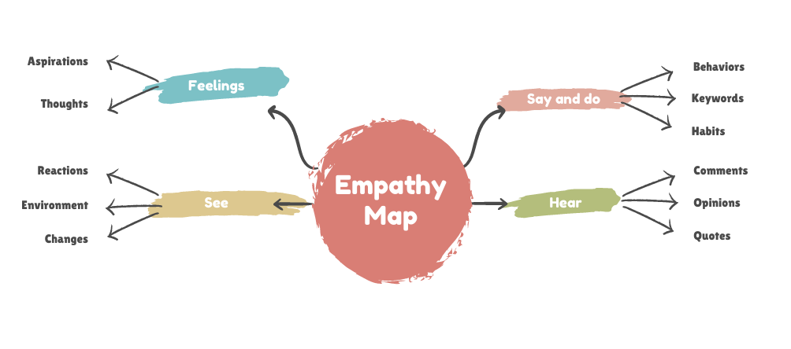


Slide 43
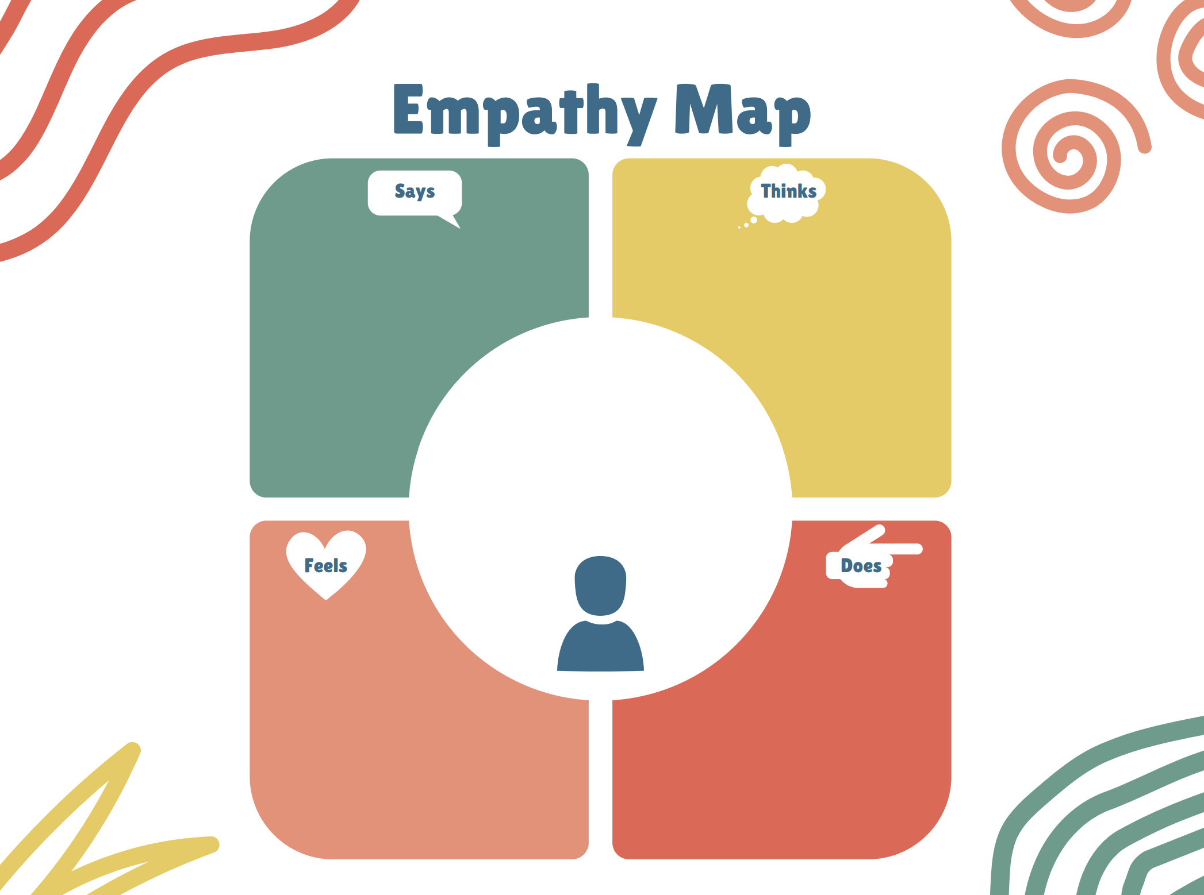

Slide 44
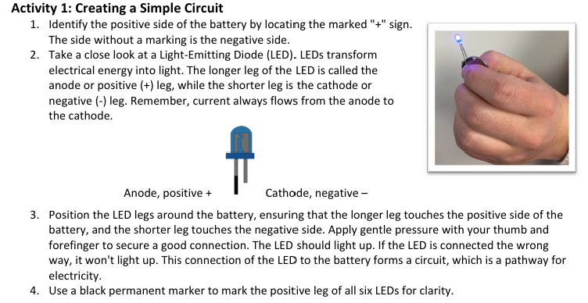
Paper Circuits

Slide 45
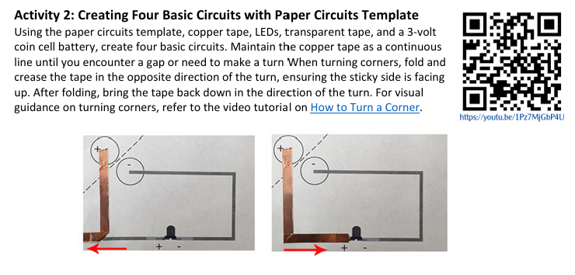
Paper Circuits

Slide 46
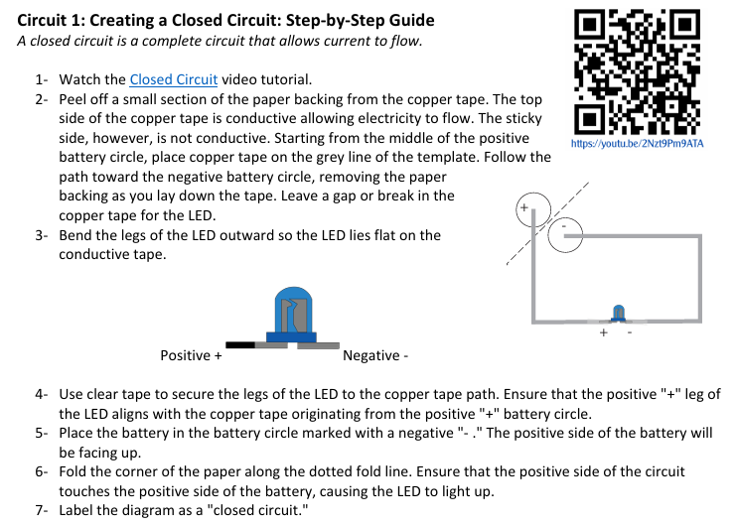
Paper Circuits

Slide 47
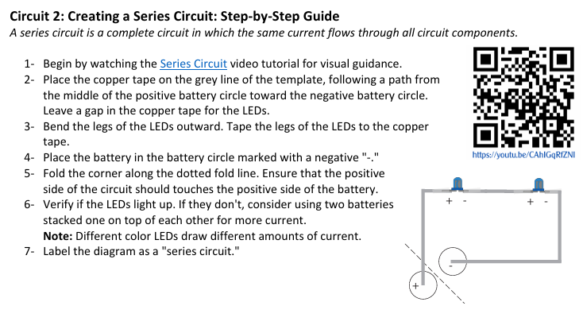
Paper Circuits

Slide 48
Lesson 5 + 6

Slide 49
Learning Intentions
Codesign a problem statement for the design thinking process
Produce a labelled diagram/s
Collaborate on possible car designs

Slide 50
Vocabulary
Problem statement
Isometric
Labelled diagram

Slide 51
Defining the problem statement
Summarise the problem (2 minutes) | Define the Problem Statement
User needs to be able to: ? ? | ___________________ (name of user) Need a way to: _________________________ (user needs)

Slide 52
Design Overview
To guide your research
Basic components (see kit)
Design and weight distribution (symmetry is key)
Key engineering challenges (efficiency, durability)

Slide 53
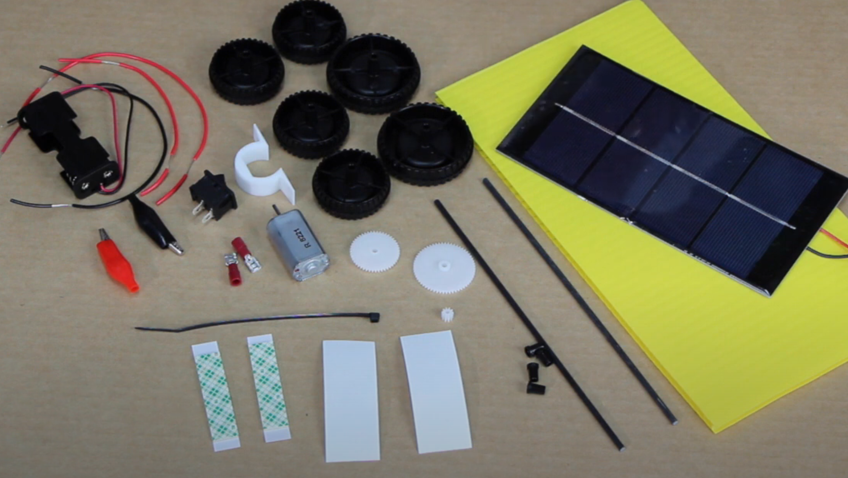
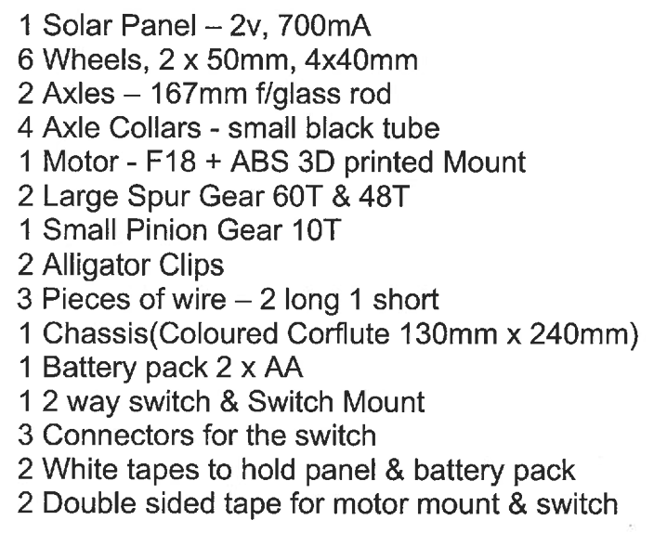
Kit Components

Slide 54
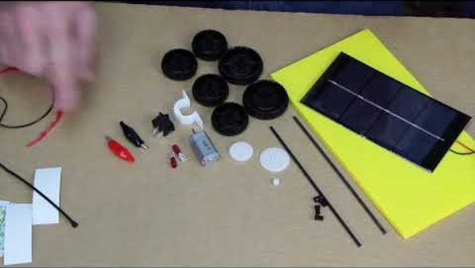
Introduction to your car
To guide your research

Slide 55

Drawing in three dimensions
Tutorial 1: How to draw a Solar Car. STEM Industry Schools Partnership Program: Mini EV Prize Challenge - YouTube
Tutorial 2: cybertruck_NCC.mp4 - Google Drive
Sketch: Use one or both of the sketch templates to create a three-dimensional drawing of your car.

Slide 56
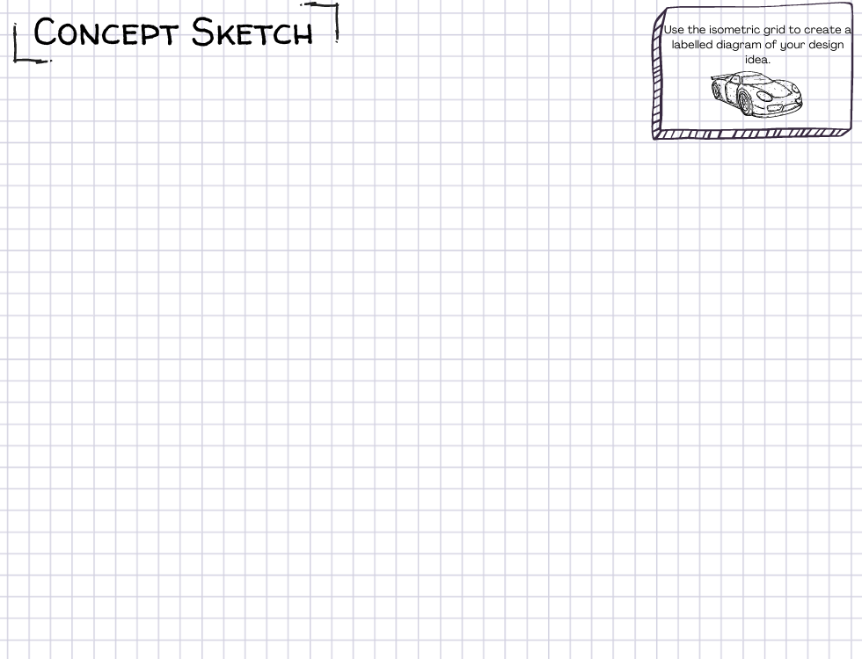
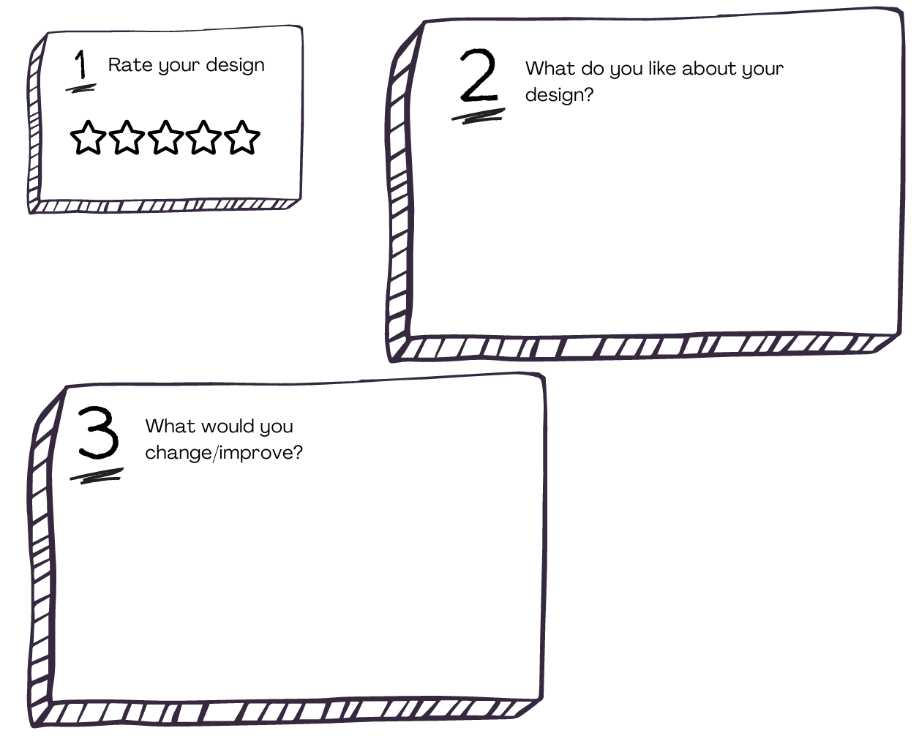
Concept Sketch #1
Produce your individual concept sketch
Compare with your group members
Complete your individual reflection
Share your reflections
Combine your ideas into ONE final group design

Slide 57
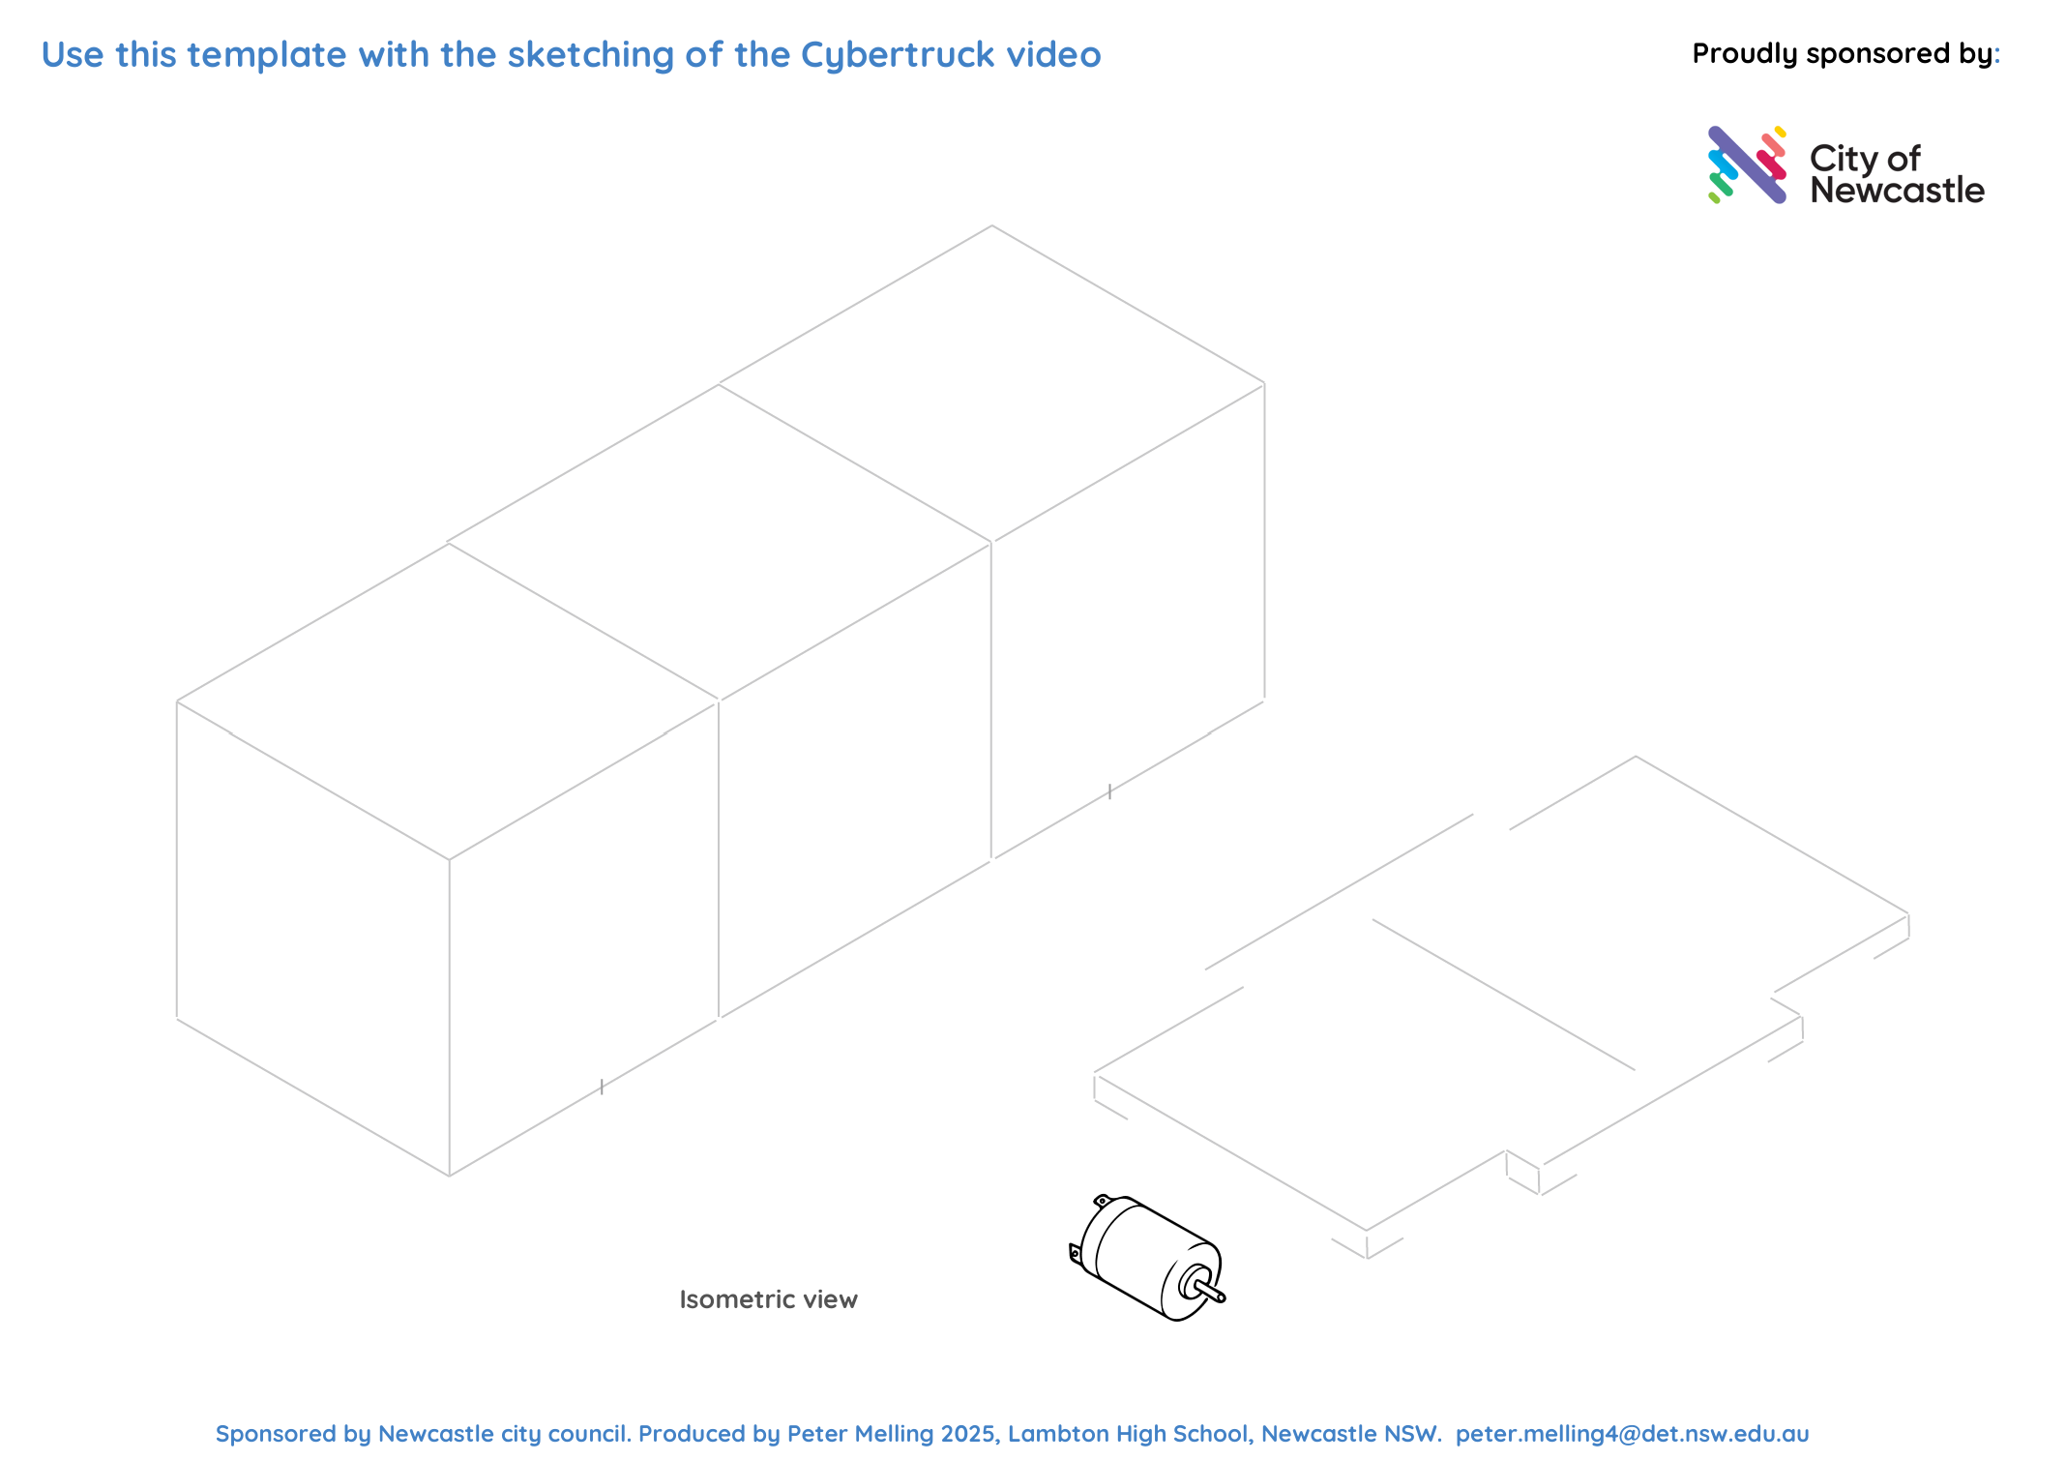
Concept Sketch #2

Slide 58
Lesson 7 - 9

Slide 59

Your Goals
Jointly construct based on the amount of time/lessons you have allocated for building, testing and evaluating.

Slide 60
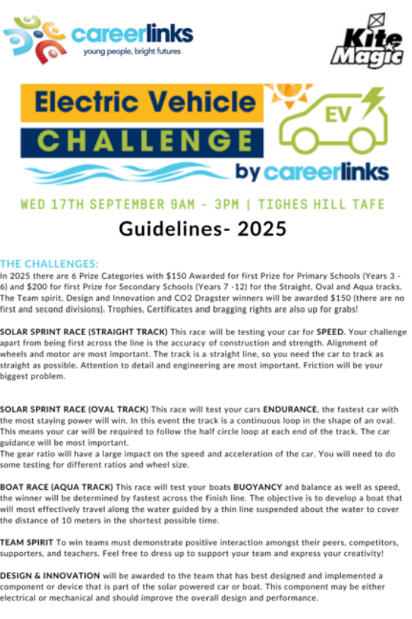
Competition Guidelines Recap
Review: Competition guidelines and watch this example of the car race.

Slide 61
Useful Video Tutorials
1. Advanced Car - Wheels
2. Advanced Car - Wiring
3. Advanced Car - Motor
4. Advanced Car - Powering Up
5. Advanced Car - Variations

Slide 62
Time to CREATE!
Now is your time to build, test, evaluate and rebuild as many times as you need to!
Think about environmental factors that impact performance
3D print options: guidance system, wheels, chassis, anything else you can imagine!

Slide 63
Lesson 10

Slide 64
Communicate
Create a one-page overview (handwritten or digital) to communicate the process of designing and building your solar car.
Your design should communicate the different elements of the design thinking cycle and include a detailed labelled diagram. Make sure you include a justification as to why you ended up with the design that you have.
If time permits or you want to really extend your thinking, you may wish to use a more detailed communication platform such as a pitch deck, virtual learning environment, website, infographic or instructional video.

Slide 65
Battle of the cars
Create a draw for your teams to battle each other before deconstructing their cars!

Slide 66
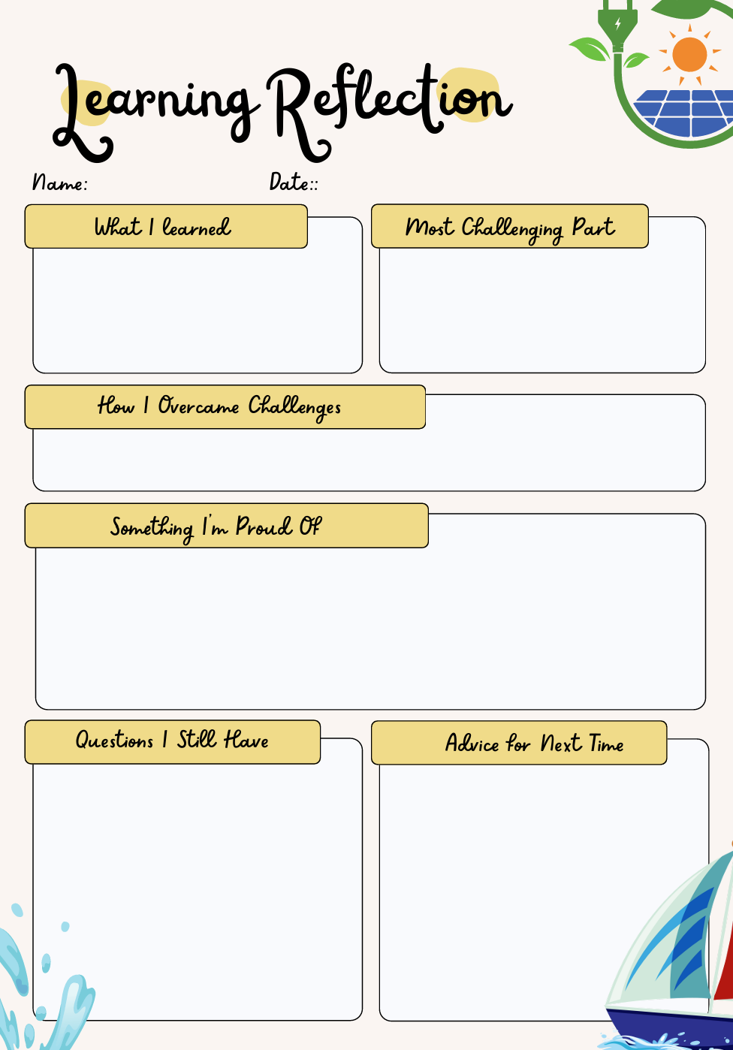
Evaluate + Reflect
Think about:
The whole process – from your original concept sketch to the final build
Modification and changes you had to make (to your design and your thinking)
How you worked as part of a team – your cooperation and commitment
The actual race day

